Slide 1

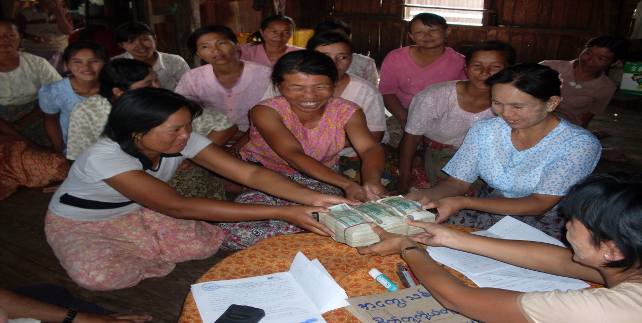


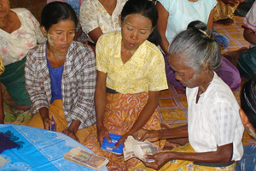
Myanmar Research | Consulting | Capital Markets
Research Services in Microfinance Sector
This information is confidential and was prepared solely for the client; it is not to be relied on by any 3rd party without Thura Swiss's prior written consent.

Slide 2
Research Services in Microfinance Sector
Section 1: Myanmar Microfinance Market
Section 2: Informal Finance Market
Section 3: Market Potential for Payday Loans
Section 4: Analysis of Payday Loan Business Ecosystem
Section 5: Distribution Channel for Payday Loans
Section 6: Market Entry and Licensing
Section 7: Summary and Recommendations for Market Entry
Section 8: M&A Target Shortlisting and Their Comparative Analysis

Slide 3
Section 1: Myanmar Microfinance Market
Regulatory Development related to Financial Sector
The government has been making a series of promising political and economic reforms which offer opportunities for investors in various industries.
Drafted new constitution of Myanmar
- New civilian government took office
- More private banks emerged
- Myanmar Payment Union established
- Microfinance Law enacted
- Adoption of floating exchange rate scrapping the 35 year used fixed exchange rate
- Foreign Investment Law enacted
- Central Bank of Myanmar Law enacted
- 12 new domestic insurance licenses issued
- Nine foreign banks received licenses to operate
- Drafted new Financial Institutions Law to replace the one drafted in 1990
2008
2011
2012
2013
2014
The constitution was drafted by the previous regime and is especially criticized for the fact that 1/4 of members of parliament are from military. Legislative power is shared among Union Parliament, Regional Parliaments and State Parliaments.
After 2010 General Election, the new civilian government with one president, two vice-presidents and 34 ministries is formed. A series of positive reforms have been carried out during the government’s term.
The new Foreign Investment Law gives foreign investors an opportunity to invest in green field opportunities of the frontier market.
The Central Bank of Myanmar Law gives more autonomy to the Central Bank and allows the bank to stand alone rather than being regulated by Ministry of Finance.
The first batches of insurance licenses to local firms and operating licenses for foreign banks have been granted.
Private microfinance licenses were also granted with the intention of poverty reduction.

Slide 4
Section 1: Myanmar Microfinance Market
Financial Sector Overview
Regulatory Body
Financial Sector Overview
4
State-owned Banks
23
Private Banks
9
Foreign Banks
Central Bank
Central Bank
Central Bank
34
Foreign Bank Representative Offices
297
MFIs
10
Finance Companies
Central Bank
Financial Regulatory Department, MOF
Central Bank
12
Private Insurance Companies
1
State-owned Insurance Company – Myanma Insurance
Myanma Insurance
Ministry of Finance
MOF – Ministry of Finance

Slide 5
Section 1: Myanmar Microfinance Market
Overview about Myanmar Microfinance
Historical Background on Development of MFIs
Microfinance operations started in Myanmar in 1950s in the form of pawnshops. Later, other sources of finance emerged such as cooperatives, small loan enterprises and social development programs. Sources of finance were very limited due to government’s close door policy.
Before 2011, borrowers could rely on pawnshops, informal lenders, development programs by NGOs and not-so-effective cooperative system run by Ministry of Cooperatives.
After the government’s open up in 2011, the Microfinance Law was enacted with the intention of forming a financial system that could allow all citizens to participate towards rural development and poverty reduction.
Main objective of this law is to reduce the poverty and promote the socio-economic lives of grass-root people.
The law provides a legal basis for the establishment of deposit taking and non deposit taking MFIs. It also allows fair competition between local and foreign MFIs.
Before the formation of Financial Regulatory Department, Myanmar Microfinance Supervisory Enterprise and Microfinance Supervisory Committee were bodies responsible for administering and monitoring of MFIs.
Recently in 2015, the two bodies were merged and formed as Financial Regulatory Department of Ministry of Finance.
All MFIs are required to submit monthly, quarterly and yearly reports to FRD.
Furthermore, Myanmar Microfinance Association has been formed as an alliance of all MFIs in the country and it serves as a bridge between the government and the private entities to work closely for the development of microfinance sector in Myanmar.
History of microfinance operations in Myanmar
Microfinance Law
Regulatory Body

Slide 6
Section 1: Myanmar Microfinance Market
Overview about Myanmar Microfinance
Policy framework related to microfinance sector
Name | Year | Type | Summary
Microfinance Law | 2011 | Law | Brief introduction on the objectives of MFIs, formation of microfinance authorities and their duties and overview description of how microfinance institutions should operate and their functions and duties.
Procedures relating to microfinance activity | 277/2011 | Notification | Some of the chapters including in this notification are rather redundant from the microfinance law. Others include allowed activities, auditing standards and auditors and restriction on confidential information of MFIs.
Notification from MSC | 1/2011 | Order | Information on minimum capital, interest rates, service fees to government authorities, license fees and yearly license fees.
Notification from MSC | 2/2011 | Order | Categorization on two types of MFIs such as deposit taking and non- deposit taking including license application form (MFIs-01) and application form for relocation, expansion and termination (MFIs-02).
Notification from MMSE | 1/2011 | Order | Instructions on reporting structures and accounting formats by MFI to the authorities. This includes member application forms, group-forming applications, profiling of the borrowers, etc.
Notification from MMSE | 1/2013 | Order | Directive on substitution of accounting structures to what was stated in notification (1/2011 MMSE) and instruction on using Chart of Accounts.
Notification from MMSE | 1/2014 | Order | Categorization of loans with a potential of bad debt and calculation of PAR (Portfolio At Risk).
Notification from MSC | 1/2014 | Order | Limitation on loan size, solvency ratio and liquidity ratio.
Notification from MSC | 2/2014 | Order | To practice effective interest rate rather than flat rate and other reporting items to MSC.
Notification from MSC | 3/2014 | Order | Information on changing of loan size limitation to 5,000 USD and directives on abroad debt financing.
Policy framework regarding to microfinance sector

Slide 7
Section 1: Myanmar Microfinance Market
Overview about Myanmar Microfinance
Overview of the Regulation and Supervision Structure
Rural Development and Poverty Reduction Working Committee
Adoption of Policy
Microfinance Business Supervisory Committee
Financial Regulatory Department (bef: MMSE)
Implementation of Policy
Licensing Supervision
Region/State and Nay Pyi Taw Council
Microfinance Business Development Working Committee
Regional/State Nay Pyi Taw Council
Financial Regulatory Department (bef: MMSE)
Supervision
Supervision
MFI
MFI
MFI
MFI
MFI
MFI
MFI
Member
Member
Member
Member
Member
Member
Member
Source: IFC (2013) and Financial Regulatory Department

Slide 8
Section 1: Myanmar Microfinance Market
Overview about Myanmar Microfinance
Number of MFIs
Since the enactment of Microfinance Law, Financial Regulatory Department approved license applications from local companies and only after some time, foreign applicants were permitted. Authorities have given licenses to 217 firms so far but since only some of them are in full function, FRD will likely scrutinize on granting of licenses to more firms in future.
977,177
Total outstanding client which represents only 1.9% of the whole population and 2.7% of rural population
USD 300
Average Loan Size
217
297
Total number of MFI branches
Total number of MFI (as of April)
93
Deposit taking MFI
124
Non-deposit taking MFI
Some of the firms acquire microfinance license just to cover up their informal lending practices.
There are two types of MFI, deposit-taking and non-deposit taking. Even if the institution is non-deposit taking, it is required by law to collect compulsory savings from its borrowers.
Not for profit MFIs are mostly INGOs and NGOs. Majority of MFIs operate for profit.
Deposit taking MFIs require more paid-up capital than non-deposit taking firms. (Detailed requirements are in Slide 16.)
Source: Financial Regulatory Department

Slide 9
Section 1: Myanmar Microfinance Market
Overview about Myanmar Microfinance
Number of MFIs
The nascent microfinance market in Myanmar shows great promise to companies looking to enter the Myanmar market. Although the market is very fragmented with many MFIs, very few firms are operating at large scale. Most of the firms are operating with loan outstanding of less than 40,000,000 MMK.
Some of the firms are constraint to serving limited number of clients since financial restraints hold them back from performing their full potential by satisfying clients’ demand. This, in turn, creates opportunities for other firms to enter the market.
Since all the co-operatives fall under Ministry of Co-operatives and effected by co-operative law, the licensed co-operative MFIs has to abide by both the Co-operative Law and Microfinance Law. However, since there are some difficulties in abiding the two laws at the same time, some of the co-operatives decide not to get the MFI license. Co-operatives have been doing microfinance business since before the Microfinance Law due to their original nature as a co-operative and therefore, the unlicensed co-operatives are not necessary to comply with the Microfinance law.
According to primary sources, approximately 20% of the total MFIs are not operating as an MFI in which those institutions acquired license just to cover up their pawn shops or informal lending practice.
In addition, small-sized local MFIs encounter difficulty in expanding their business across regions due to limited funding capacity and lack of information system and management capabilities to handle more loans compared to some strong local MFIs with corporate background and other Foreign MFIs.
Source: Financial Regulatory Department

Slide 10
Section 1: Myanmar Microfinance Market
Overview about Myanmar Microfinance
Number of MFIs
The number of MFIs which have been granted licenses has reach 15.
No | Name of the Foreign MFIs
1. | ACLEDA MFI Myanmar Co., Ltd.
2. | LOLC Myanmar Microfinance Co., Ltd.
3. | BG Microfinance Myanmar Co., Ltd.
4. | Pacific Star Finance Limited
5. | Hana Microfinance Limited
6. | AEON Microfinance Limited
7. | BC Finance Limited
8. | Card Myanmar
9. | Fullerton Myanmar Co., Ltd.
10. | ASA Microfinance Myanmar Limited
11. | BS Capital Myanmar Corporation
12. | BRAC Myanmar Microfinance Co., Ltd.
13. | Global Money Service Co., Ltd.
14. | Vision Fund Co., Ltd
15. | Early Dawn Co., Ltd
Some of the firms have only received temporary license which is valid for 1 year. Companies are instructed to start operations within a few months after receiving the temporary license. Actual license will be granted before the temporary license expires.
Foreign MFIs are not allowed to receive funding from any local bank and financial institution. They can rely on their parent company or other foreign firms for financing. Even doing so requires approval from the Central Bank.
Although equity funding is unlimited, the maximum amount of debt funding a foreign MFI can receive is 3 million USD although debt to equity ratio is allowed at 5:1. Regardless of the amount of equity a foreign MFI has, the maximum amount of debt funding is capped at 3 million USD. Eg. Supposing a foreign MFI has equity funding of 2 million USD, the maximum amount of debt funding it could receive is 10 million which is 5 times of 2 million equity according to the ratio. However, as debt funding is capped at 3 million, the MFI cannot receive more than the cap.
According to industrial experts, foreign firms could take over local firms with the fact that they have strong financial capabilities and international experience in microfinance business.
Source: Financial Regulatory Department

Slide 11
Section 1: Myanmar Microfinance Market
Overview about Myanmar Microfinance
Market Size
According to Financial Regulatory Department, Myanmar’s microfinance market is worth approximately 281 million USD as of 2014. However, only a fraction of the actual market is being served at the moment as there is limited supply to fulfill the large demand.
State/Division (incld: Nay Pyi Taw) | 15
Townships | 201
Wards | 1641
Group of Villages | 2577
Villages | 6087
Number of Borrowers | 977,177
 | MMK (million) | USD (million)
Total loans disbursed | 288,413 | 281.38
Total deposit amount | 35,281.87 | 34.42
(1 USD = 1025 MMK)
INGOs influence most of the rural areas since they have strong experience in microfinance sector and are capable of managing the clients where most of their clients come from agricultural sector.
Center locations, being eyed by most MFIs include Yangon, Bago, Mandalay, Ayeyarwaddy and Sagaing.
Ayeyarwaddy serves as a key delta region for farmers and agricultural sector comprising a total of 6.18 million population which is around 12% of country population. The rural population of the Ayeyarwaddy Division displays more than 80% of the division population in which there is still a large market left for microfinance services not being reached out by the MFIs yet. Small-businesses in Ayeyarwaddy are very diversified where one can see various types of agri-businesses, poultry farms, fishing and other traditional businesses.
Recently, Bago demonstrates as the most popular destination for expansion by MFIs due to its convenient logistics location from Yangon and the rural population of more than 3.4 million, which is 70% of 4.86 million total population.
Source: Financial Regulatory Department

Slide 12
Section 1: Myanmar Microfinance Market
Overview about Myanmar Microfinance
Market Size
The Myanmar microfinance market is still at the stage of immaturity where there are still unreached demand awaiting for the boom, however; according to the comparison with client growth and loans disbursement growth, the growth of loans disbursement outweigh that of the client growth which shows imbalances in the two growth. Therefore, we can say that the market is expanding vertically where MFIs seeking to increase average loan size which enables to increase the amount of loans disbursement.
The projection of loans disbursement starting from 2015 – 2018 is based on assumption of growing average loan size and multiply it with the number of borrowers for each year.
The below graphs show average loan size per person (2013 May – 2018) and loans disbursement (2013 May – 2018) estimated projection.
Source: 2013 May Financial Regulatory Department Workshop meeting, 2014 May UNDP Myanmar Microfinance Sector Issue Brief

Slide 13
Section 1: Myanmar Microfinance Market
Overview about Myanmar Microfinance
Analyze the loan portfolio by types of loans
According to Financial Regulatory Department, the MFIs are encouraged to practice group lending model.
In addition, almost all the MFIs practice group lending model because it carries less risk than lending to individuals as the group members are bound to cover the loss if one of the members fail to repay their debt.
There are very limited number of MFIs who practice individual lending model.
Loan Products
Type of Product | Remarks
Agriculture Loan | Specialized loan for farmers based on crop cycles Loans are disbursed at the beginning of crop season when farmers need working capital, followed by collection of interest and principal after the harvest.
Livestock Loan | Specialized loan given for animal-rearing. Interest is collected during the loan term since livestock can generate steady income which is different from agriculture loan.
Micro-Enterprise Loan | Loans given to people who are engaging in small size income generating type of profession such as wood carving and sewing.
Consumer Credit | Financing purchase of non-investment goods that are consumed such as mobile phones and other essential lifestyle supporting items.
Personal Loan | A type of loan given out to a household to finance anything they need for their family such as financing their children’s education.
Source: In-depth Interviews

Slide 14
Section 1: Myanmar Microfinance Market
Overview about Myanmar Microfinance
Analyze the loan portfolio by loan purposes
Client types vary from different MFIs according to the focus on different areas such as urban or rural, however; the rules and regulations direct all the MFIs to operate in 50:50 ratio of urban and rural.
Most of the INGOs focus more on rural areas in which more than 50% of the client portfolio is from agricultural sector.
Other types of client include low-income factory workers, micro-businesses, middle income people for credit financing and hawkers, etc.
Farmers | Farmers need financing for their cropping activities and their farming equipment. According to primary sources, the loan size for farmers are decided per acre which is average around 100 – 150 USD per acre. Some MFIs offer agriculture loan mainly targeting on agricultural related activities where others offer seasonal loans which are suitable to any farming business including gardening, etc.
Micro-enterprises | Micro-enterprises need funding to expand their businesses and the needs to equip their business. Other small type of micro-enterprises also include self-employed who are engaged in a petty shop or handicrafts. Average loan size is approximately 300 USD.
Low-income workers | Low-income workers include factory workers, employees, government employees and so on. According to a primary source, one of the MFIs offer credit financing and other loan products to the workers and the loan reviewing process are tied to the respective HR departments which makes the MFI easy to monitor their activities. According to the order 3/2014 by MSC, financing luxury items are prohibited, however; some MFIs seems to be doing the financing of household items such as washing machines, televisions, mobile phones, etc. According to the primary source, since the luxury items are not identified in the order, the MFIs still have the chance to convince the authorities by reasoning that the items can generate income for the clients.
Street Hawkers | Street hawkers are identified as high risk clients since they are easily transported by their nature of merchandising. Therefore, most of the MFIs try to avoid the street hawkers while only very few of them paid out loans to them.
Women | Women are centered as the first priority since the default rate of women is much lower than that of men. Another fact includes gender equality where MFIs want to give equal right to women.
Source: In-depth Interviews

Slide 15
Section 1: Myanmar Microfinance Market
Competition Dynamics
Market share of key MFIs and segmentation: international MFIs and local MFIs vs. financial cooperatives
Apart from MFIs, there are the following kinds of formal providers of micro credit in Myanmar.
Banks | Myanmar Agricultural Development Bank (MADB), a state-owned agricultural development bank, and Global Treasure Bank , a private bank specialized in livestock and fisheries development – previously Myanmar Livestock and Fisheries Development Bank (MLFDB) provide micro credit to microenterprises as well as individuals.
Cooperatives | Cooperatives run by Ministry of Cooperatives focus primarily on deposit mobilization and microloans in urban areas. Financial cooperatives are organized under the Union of Savings and Credit Federation (tertiary level society), which, as of March 2012, had 41 savings and credit federations (secondary level societies) and 1,625 primary level societies who work mainly for grass root people. The Central Cooperative Society operates 46 MFIs in 14 regions.
Myanmar Small Loan Enterprise | Myanmar Small Loan Enterprise (MSLE) was formed under the Ministry of Finance and pawnshops were registered with MSLE. A few years back, Yangon City Development Committee and respective regional city development committees have been assigned as regulatory and administrative bodies for pawnshops. MSLE also went through a transition process and transformed as Microfinance Supervisory Enterprise (MSE) and took new responsibilities as a microfinance supervisory body.
NGOs | Before the passage of Microfinance Law, NGOs have been major contributors in Myanmar’s micro credit sector. Before 2011, PACT in collaboration with UNDP was the only NGO which was permitted to operate micro lending legally. After the enactment of Microfinance Law, major NGOs and INGOs have received MFI licenses. Leading organizations include GRET, PACT, Save the Children and World Vision. Having strong financial and HR capability, NGOs can reach out to clients in different geographical locations and thus, the client base is much greater than private MFIs.
Source: In-depth interviews, Microfinance in Myanmar Sector Assessment Report

Slide 16
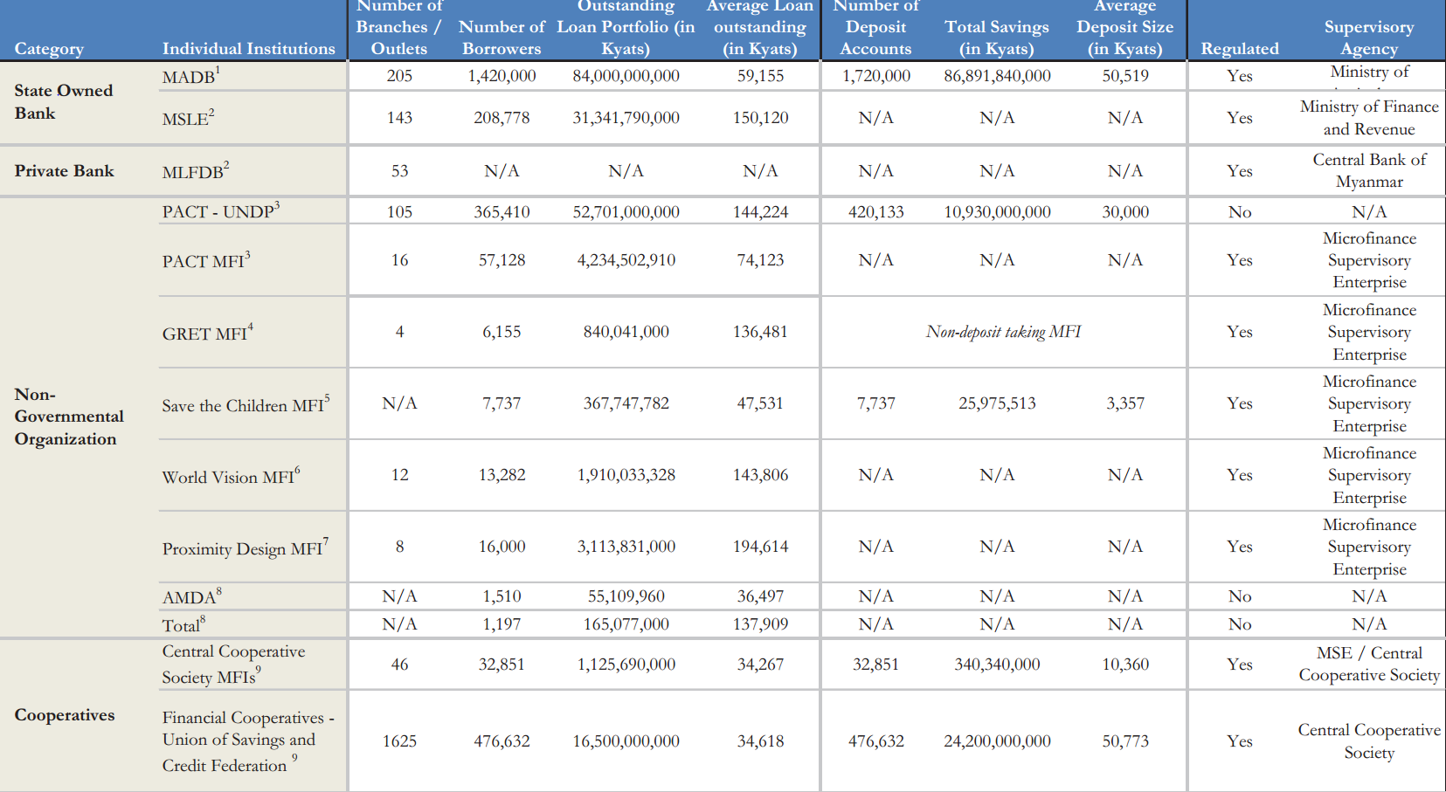
Section 1: Myanmar Microfinance Market
Competition Dynamics
Market share of key MFIs and segmentation: international MFIs and local MFIs vs. financial cooperatives
The following illustrates the number of borrowers, loan portfolio and average loan outstanding of different sources as of 2012.
Source: Microfinance in Myanmar Sector Assessment Report

Slide 17
Section 1: Myanmar Microfinance Market
Products offering characteristics by leading MFIs
Interest rates and Repayment
Interest
Repayment
According to Microfinance rules and regulations, interest rates and deposit rates are limited as below.
According to notification 2/2014, the Financial Regulatory Department has instructed to practice the declining payment method as flat payment method charges high interest rate and could be a burden for the borrowers with flat payment method.
There are two methods of repayment systems practiced by MFIs;
There are still a few MFIs that practice the flat repayment system.
However, as mentioned in individual and group lending scenario, these MFIs will be also obligated to transform their payment method to the method instructed by the government.
Interest Rate
Deposit Rate
30% Annual Effective Rate
15% Annual
Collects interests on the loan amount borrowed and charge fixed interest every month until the end of loan term
Flat payment
Interest rate varies according to the repayment system of MFI where bullet payment exceeds 30% and declining payment takes 30%.
Therefore, the authorities ordered all the MFIs to practice declining payment method with instructions on calculations.
Deposit rate is effective for both voluntary savings and compulsory savings.
Compulsory savings take a specific percentage of the loan amount averaging around 1-5% which can vary from different MFIs.
Collects interests based on the loan amount left over after each repayment
Declining payment (Effective Rate)
Source: In-depth interviews, Desk Research

Slide 18
Section 6: Market Entry and Licensing
Products offering characteristics by leading MFIs
Deposit taking vs Non-deposit taking
Most of the MFIs in Myanmar operate as non-deposit taking institutions where only few of them accept voluntary deposits.
Usually, voluntary deposits are utilized in the operation and there is no limited amount in accepting deposits.
The minimum amount of voluntary savings is 1,000 MMK and the compulsory savings usually takes place 1% of the loan amount, however; some of the MFIs take around 5% of the loan amount.
Capital Requirement
Paid-up capital varies according to the type of institution. The amount is 30,000 USD for deposit taking institutions and 15,000 USD for non-deposit taking institutions.
Deposit taking institution
Non-deposit taking institution
The quota of compulsory saving varies for different MFIs and most of time, it is 1% of the loan amount.
Voluntary Deposit
Compulsory Saving
Compulsory Saving
Compulsory Saving reserve
Voluntary Deposits can be used in the operation
Savings are paid out at the end of the loan term
Source: In-depth Interviews

Slide 19
Section 1: Myanmar Microfinance Market
Products offering characteristics by leading MFIs
Application Process, Duration
Based on the geo-economic information about the region and various towns and villages, MFI will then approach top location.
Geo-Economic Survey of Region
Then MFI visits the village and tries to gather first hand information about the population of that location, their religion, types of trades, skill, needs, and financial status.
Location Appraisal
Conduct a survey to evaluate potentiality for the operations in the location, few key parameters are combined population, level of poverty, accessibility, political stability and safety.
Selection of Location
After selection of location, interested member form self-selected four to six member groups to serve as guarantors for each other.
Group Formation
When formed group meets the minimum requirements, it begins Compulsory Group Training designed to educate clients on process and procedures of microfinance loans.
Training of Borrowers
Customer details, their business, and earning capacity are scrutinized and judged to access repaying capacity.
Scrutiny and Underwriting
Collection meetings are held on a weekly/monthly basis by field officers to conduct all financial transaction.
Financial Transaction
Source: In-depth interviews

Slide 20
Section 1: Myanmar Microfinance Market
Profiles top 10 local MFIs
No. | Name of MFI | Head Quarter Address
1. | Pyae Mahar | Room 506, Building E, 1st Street, Sinmalite Highway Complex, Kamayut
2. | OK Myanmar | No 2, Kanbawza Avenue, Kamayut
3. | Mingalar Myanmar | No 47, Than Lwin Road, Kamayut
4. | Tun Foundation | Kyi Myint Taing Branch 1st Floor, Zay Gyi Road
5. | Myanmar Development Partners | Room 602, Bayintnaung Tower, Kamayut
6. | Tauk Htun | Building 5/203, Yan Aye Street, Yankin
7. | Straits Microfinance | No 14, Shwe Mya Yar Housing, Corner of 124th Street & Mya Yar Gone Street, Mingalar Taung Nyunt
8. | Yin Aye Microfinance
9 | Internet Wallet | No 321, Bogyoke Aung San Street, Kyauktada
10. | Kispa Nadi Express | No 10, Mingalar Street, 16 Ward, Yankin
** Almost all MFIs in Myanmar are 100% equity funded.

Slide 21
Section 1: Myanmar Microfinance Market
Profiles top 10 local MFIs, Pyae Mahar Microfinance
Pyae Mahar has been the most progressive MFI in the sector in terms of operations. Its Founder and Managing Director takes the role of Chairperson at Myanmar Microfinance Association and has close connections with government bodies. It is a firm operating with great transparency.
Description of Business | Pyae Mahar Microfinance was founded in September 2012 with a vision to improve the lives and futures of vulnerable populations and to create better economic opportunities for them. It was the pioneer among private MFIs after the enactment of Microfinance Law in 2011.
Main Markets and Main Products | General Loan Bi-weekly repayment for 25 installments 1st Cycle – 50 USD 2nd Cycle – 70 USD 3rd Cycle – 100 USD
 | Agri Loans (For Production of betal leaves, paddy, vegetables, water-mimoso, etc.) Only interest bi weekly, principal repayment is at harvesting time 100 to 300 USD
 | Emergency Health Loans Only interest for grace period 4 bi-weekly installments and repayment for 10 bi-weekly installments 50 USD
Key Financials | Total Loan Book | 834,000,000 MMK
 | Saving Deposit | 260,000,000 MMK
 | Average Loan Size | Varies on the type of loan
 | Non-Performing Loan | 0
 | Profit | - 8,957,526 MMK (2012-2013 FY) - 37,673,155 MMK (2013-2014 FY)
Key Operational | Townships | 5
 | Villages | 351
 | Households | 44,921
 | Client base | 19,398
Source: In-depth interviews

Slide 22
Section 1: Myanmar Microfinance Market
Profiles top 10 local MFIs, Pyae Mahar Microfinance (Contd)
Success Factors | Management Background | Pyae Mahar’s Managing Director, Mr Minn Aung, has previously worked at PACT and Myanmar Agricultural Development Bank from which he earned skillful knowledge on how to operate and maintain a successful MFI. He has many years of experience in the finance sector hence the appointment of his as chairman of MMA.
 | Skilled and Proficient Staff | Most employees, along with loan officers, working for Pyae Mahar have microfinance background and are ex-employees of well-established MFIs in Myanmar. These loan officers understand how to approach clients, collect repayment and review loan systematically.
 | Loan Review Method | Head office prepares daily the amount to be collected from whom for repayment for each loan officer thus the company can stay on track of managing their finances.
Future Plan | Pyae Mahar has been gaining wide arrays of interest from foreign investors looking to expand their operations in Myanmar. However, the company is still cautious to make immense changes to the current structure. If the company decides to expand their operations in the future, they will consider Bago as their target area due to business opportunities offered in the region such as the availability of low-income population with variety of occupations.
Source: In-depth interviews

Slide 23
Section 1: Myanmar Microfinance Market
Profiles top 10 local MFIs, OK Myanmar Microfinance
Description of Business | OK Myanmar received license to operate a Microfinance Institution in the year 2014. Its ultimate goal is to become a financial institution after entering the market as a MFI. They practice both group lending and individual lending. Individual lending requires a guarantor who has a solid family background. Repayment system is structured to be paid every week by borrowers via declining method.
Main Markets and Main Products | OK Myanmar only has one loan product and it is a general loan given out to all of its clients.
Key Financials | Loan Portfolio | Non-disclosed
 | Average Loan Size | 150,000
 | Non-Performing Loan | 0
Key Operational | Yangon | 44 townships
 | Customer Base | Over 4,000 clients
Profile of its clients and their needs | Clients of OK Myanmar can be described as casual, small business owners. The MFI plans to extend loans to middle income persons in the future as the MFI expands.
Source: In-depth interviews

Slide 24
Section 1: Myanmar Microfinance Market
Profiles top 10 local MFIs, Mingalar Myanmar Microfinance
Description of Business | Starting from August 2012, Mingalar Myanmar received the license to operate in 10 townships in Yangon. Mingalar Myanmar is a deposit-taking non-governmental organization by nature but operates a for-profit business model. It is important to note that Mingalar Myanmar has been conducting Microfinance operations before the passing of Microfinance law thus it does not believe in abiding by every clause established by the law. For example, it provides much higher loan size than the instructed 5000 USD. In fact, the average loan size for Mingalar Myanmar doubles the instructed loan size. Additionally, it extends loans to individuals rather than practicing the traditional group lending model. The company has been profitable according to its practices but risks losing operating license due to breaching of the law.
Main Markets and Main Products | There is only one loan product provided by Mingalar Myanmar, which is the Micro-Business loan. This loan requires a guarantor who will be held responsible to repay their loan if the client fails to do so.
Key Financials | Loan Portfolio | 2,500,000,000 MMK
 | Average Loan Size | 6,000,000 MMK (Extends loan to up to 10,000,000 MMK and Mingalar Myanmar believes that it would make a loss if it provides loans under 200,000 MMK.)
 | Loan term | 50 weeks / Weekly repayment
 | Interest Rate | 2.5% / Flat rate
 | Non Performing Loan | 3 percent of portfolio
Key Operational | Operating Areas | Operates mainly in urban areas of the permitted 10 townships in Yangon
 | Customer Base | Over 3,000 households
Profile of its clients and their needs | Mingalar Myanmar targets small-medium enterprise owners who has guarantors who will be responsible in case of bad loan. Mingalar Myanmar does not lend to staffs or employees. Clients of Mingalar Myanmar are those who need support to fund their businesses and, or take the business to another level.
Source: In-depth interviews

Slide 25
Section 1: Myanmar Microfinance Market
Profiles top 10 local MFIs, Tun Foundation Finance
The MFI is operated as independent financial company owned by Tun Foundation Chairman, Mr Thein Tun, a well-knowned tycoon who has business footprints in banking, manufacturing, hotel and FMCG sectors. He has about 15 companies and most popular ones are Tun Foundation Bank, Mandalay Hill Resort Hotel and Myanmar Golden Star which is the local partner for Pepsi. Majority of the profits of Tun Foundation Bank goes to providing funding for the poor and awarding scholarships for students with financial constraints.
Description of Business | Started from 2008 for Cyclone Nargis re-habilitation of homelands in Kun Chan Kone/Za Lun Officially start operation as an MFI in 2011 with official license Non-deposit taking institution
Main Markets and Main Products | Agriculture loan Only for group lending (includes 5-10 people in a group) Loan term → -Seasonal depending on the type of agriculture product -Usually 4 months (minimum) and 10 months (maximum)
Key Financials | Loan Portfolio | 105,000,000 MMK
 | Average Loan Size | -30,000 MMK per acre -300,000 MMK maximum per person depends on the region’s pay back pattern -however, it has been upgraded to 700,000 MMK per person
 | Non-Performing Loan | 0
Key Operational | Main Head Office | Yangon
 | Ayeyarwaddy | 27 villages in townships such as Zalun, Warr Khae Ma, Ma U Bin (Whole)
 | Mandalay | Kyauk Pataung (as a whole)
 | Yangon | Kun Chan Gone (36 villages as a whole)
 | Client base | More than 3,000 clients (only to whom that owns wet land) Ayarwaddy – 2,700 clients Mandalay – 600 clients Yangon – 500 clients
Profiles of its clients and their needs | 100% farmers Since the MFI mainly focuses on agriculture loans, most of the clients are from Ayeyarwaddy region.
Source: In-depth interviews

Slide 26
Section 1: Myanmar Microfinance Market
Profiles top 10 local MFIs, Straits Microfinance
Straits Finance has sister companies in trading and travel & tours sectors.
Description of Business | Gained license in July 2013 to operate in 20 townships
Main Products | Types of Loan →Regular Loan, Business Loan, Livestock & Fisheries Loan, Agriculture Loan / Both group and individual lending Loan Term → 6 months Loan Cycle → Loans are disbursed in cycles of 6 months each. The maximum amount for a borrower in the first cycle is 100,000 MMK and the loan amount is raised in next cycles depending on the borrower’s performance.
Credit Decision Process | The data of loan applicants are collected by loan officers and the Branch Manager makes the decision after completing background checks.
Key Financials | Loan Portfolio | 500,000,000 MMK
 | Average Loan Size | 400,000 MMK
 | Interest Rate | Monthly rate – 2.5%, Declining Method, Weekly Repayment
 | Non-Performing Loan | 0
Key Operational | Main Head Office | Yangon
 | Areas | Yangon, Bago, Pathein
 | No of Loan Officers | 12
 | Customer Base | 4000
Future Plan | Straits Finance is progressing with vertical growth with increase in loan size. Thus, in order to expand horizontally, ongoing staff trainings are being provided to ensure the staffs have the capability to serve more clients. Will introduce new loan products based on the demand and market situation. The MFI thinks of using mobile payment/money as an option but prefers doing distribution and collection in person by loan officers to build client relations and trust as well as to assess the improvements of borrowers such as living conditions.
Source: In-depth interviews

Slide 27
Section 1: Myanmar Microfinance Market
Profiles top 10 local MFIs, Myanmar Development Partners
Description of Business | Gained license in Nov 2012 to operate in 19 townships Started in 2012 with initial capital which was donated by German Saving Bank Foundation (GSBF) with the intention of improving the lives of the poor by providing financial assistance for their businesses or consumption. Although the seed money comes from GSBF, MDP stands independently under the management of its board of directors. GSBF still serves as an advisor to MDP in guiding their operations to ensure the purpose of helping the poor is achieved. MDP claims itself as non-profit taking MFI since the initial agreement with GSBF restricts majority of the profit to be invested in the business to raise the capital. However, MDP is drafting its Articles of Association which will determine new terms on the utilization of profit. It will determine the % of profit to be invested in MDP’s operations and the % to be shared among board of directors. (MDP also runs knowledge sharing and vocational training programs.) Deposit-taking. Weekly compulsory saving of 500 MMK.
Main Markets and Main Products | Women Centered Types of loan →Agriculture Loan, Business Loan / Individual Lending Loan Term → 3 months, 6 months (Borrower can choose preferred term.)
Loan Application Process | Loan officers visit villages and introduce their organization, loan types and eligibility criteria. Individuals who are interested are required to apply for membership with MDP. Every 20 or more borrowers (not more than 40) have to team up and form a center (group of borrowers) and elect someone from the group to be the Center Leader who takes the responsibility of collecting weekly repayments. If a village or a quarter has borrowers less than 20, they will be asked to join the centers nearby. Loan officers from the nearest branches disburse the loans in person but for repayment, Center Leaders have to collect on their behalf and pay them. The intention of putting borrowers into one group is for easy management and the Center Leader and each of the members are not responsible to pay back the loan of one if he/she fails to do so.
Key Financials | Loan Portfolio | 600,000,000 MMK
 | Average Loan Size | 100,000 MMK (Every member is entitled for only 50,000 MMK for the first time. Depending on his performance, the loan amount will be increased.)
 | Interest Rate | Monthly rate – 2.5%, Declining Method, Weekly Repayment
 | Non-Performing Loan | 2 Cases (The borrower died in the 1st case.)
 | Portfolio at risk | 3% of portfolio
Key Operational | Main Head Office | Yangon
 | Operating Areas | 12 Townships in Yangon
 | Customer Base | 2600
Source: In-depth interviews

Slide 28
Section 1: Myanmar Microfinance Market
Profiles top 10 local MFIs, Tauk Htun
Description of Business | Tauk Htun is a private company formed in 2009 with majority of shareholders being key members of Union Solidarity and Development Party, a major political party which won more than 60% of seats in the parliament. The company was formed with the intention of providing credit to those in need and some amount of its profit is donated to the party. It started providing loans to farmers in collaboration with cooperatives since it was formed. When the Microfinance Law was enacted in 2011, it decided to apply for a license to go deeper into the business and was granted the license in 2012 to operate in 45 townships of Yangon. Deposit Taking Institution
Main Products | Types of Loan →General Loan / Group Lending Loan Term → Minimum 3 months (Negotiable) Loan Cycle → 3 months (Adjustable). The maximum amount of loan for every cycle is 30,000 MMK.
Loan Disbursement and debt collection | Borrowers are required to be the members of Tauk Htun. Tauk Htun appoints one of its borrowers as an agent representing borrowers in that specific township and loan disbursement and collection takes place via that person. Out of 2.5% interest Tauk Htun gets, the agent entitles commission of 1%. The agent then appoints sub agents who are responsible for each sub areas such as quarters as the 1% commission is shared based on their mutual agreements. However, these agents are not bound to pay back the debt on behalf of the borrowers in case of bad debt.
Key Financials | Loan Portfolio | 500,000,000 MMK
 | Loan amount | 30,000 MMK
 | Interest Rate | Monthly rate – 2.5%, Declining Method, Weekly Repayment
 | Bad Debt | Approximately 60% of loan outstanding
Key Operational | Main Head Office | Yangon
 | Areas | Operating in 44 out of 45 townships. The township which has been left out is due to its remote location and difficult accessibility such as transportation.
 | Customer Base | Non-disclosed
Future Plan | No plan to expand the operations as it is now in the state of trying to collect the debt which are at risk to get back the amount of capital it has invested.
Source: In-depth interviews

Slide 29
Section 1: Myanmar Microfinance Market
Profiles top 10 local MFIs, Internet Wallet
Internet Wallet entered the microfinance business with the intention of conducting it in digital version, i.e using mobile payment platform for loan disbursement and collection.
Apart from the microfinance business, Internet Wallet is jointly implementing the new ticketing system with state-owned Myanma Railway. The system is implemented using modern technology and techniques and will be launched very soon.
Description of Business | Gained license in August 2012 to operate in 3 regions, Yangon, Mandalay and Bago. Deposit Taking Institution.
Main Products | Types of Loan →General Loan / Group Lending Loan Term → Negotiable / Less than 6 months Loan Cycle → Loans are disbursed in cycles of maximum 6 months each.
Credit Decision Process and Loan Disbursement | Before starting operations in a specific area, Internet Wallet gather the most important information on the number of MFIs operating in the area from the Financial Regulatory Department. If there are already a few competitors in place, Internet Wallet will quit from entering the market as they perceive borrowers could be taking loans from different MFIs and thus, the bad debt risk could be high. The data of loan applicants are collected by loan officers and the Branch Manager makes the decision after completing background checks. Loan disbursement and debt collection goes manually through loan officers at this moment.
Key Financials | Loan Portfolio | Non-disclosed
 | Average Loan Size | 60,000 MMK (The loan amount starts from 40,000 MMK to 70,000 MMK, depending on the borrower and other factors.)
 | Interest Rate | Monthly rate – 2.5%, Declining Method, Weekly Repayment
 | Non-Performing Loan | 0
Key Operational | Main Head Office | Yangon
 | Areas | Currently serving Yangon and Bago. Planning to expand to Mandalay soon.
 | Customer Base | 300
Future Plan | Since Internet Wallet has already developed mobile payment infrastructure for its sister company, Internet Wallet, it has the experience, capacity and capability to develop a separate module to be used as a distribution medium for Internet Wallet. Once Speed Kyat reaches stable condition, Internet Wallet will start to develop the module based on the lessons learnt from Speed Kyat.
Source: In-depth interviews

Slide 30
Section 1: Myanmar Microfinance Market
Profiles top 10 local MFIs, Kispa Nadi Express
Kispa Nadi Express is the sister company of Internet Wallet. Before entering the microfinance business, the company was the pioneer in introducing contactless smart card which can be used for the payment of public transportation fares, bill payment and limited use in small payments in retail sector. Although it is still the monopoly in the market, the Ipay model has not been successful due to the lack of infrastructure, public awareness and the cash-oriented culture. However, Ipay is expanding its electronic payment service in both public and private transportation.
Description of Business | Kispa Nadi Express got microfinance license in 2012.
Main Products | Types of Loan →Regular Loan / Group Lending Loan Term → Negotiable / Less than 6 months Loan Cycle → Loans are disbursed in cycles of 6 months each. The loan amount will be increased in next cycles depending on the borrower’s performance.
Credit Decision Process and Loan Disbursement Process | Like Internet Wallet, it also gathers information on existing MFIs and runs surveys. The data of loan applicants are collected by loan officers and the Branch Manager makes the decision after completing background checks. Loan disbursement and debt collection are conducted manually by loan officers.
Key Financials | Loan Portfolio | Non-disclosed
 | Average Loan Size | 60,000 MMK (The loan amount starts from 40,000 MMK to 70,000 MMK, depending on the borrower and other factors.)
 | Interest Rate | Monthly rate – 2.5%, Declining Method, Weekly Repayment
 | Non-Performing Loan | 0
Key Operational | Main Head Office | Yangon
 | Areas | Yangon
 | Customer Base | Non-disclosed
Future Plan | The company will be expanding its services with a focus on Yangon primarily. To expand its services in other locations is not a priority as it takes a long time
Source: In-depth interviews

Slide 31
Section 1: Myanmar Microfinance Market
Profiles top 10 local MFIs, Yin Aye Finance
Yin Aye Finance has been progressing slowly as the owner cannot pay full attention to microfinance business as she is running other business as well. Furthermore, due to its limited financial capability, the company will be expanding its operations only at a slow pace.
Description of Business | Gained license in May 2012 to operate in Thanlyin (a township of Yangon) and Nyaung Oo in Mandalay Region. Later, it increased its paid up capital and applied for a permit to operate in another township in Yangon which is North Dagon.
Main Products | Types of Loan →Regular Loan / Group Lending Loan Term → Negotiable / 6 months in Yangon and 10 months in Nyaung U Loan Cycle → Loans are disbursed in cycles of 6 months each. The loan amount will be increased in next cycles depending on the borrower’s performance.
Credit Decision Process and Loan Disbursement Process | The data of loan applicants are collected by loan officers and the Branch Manager makes the decision after completing background checks. Loan disbursement and debt collection are conducted manually by loan officers.
Key Financials | Loan Portfolio | 260,000,000 MMK
 | Average Loan Size | 400,000 MMK / The loan amount starts from 100,000 MMK to maximum to 1,000,000 MMK in Yangon whereas the maximum is 600,000 MMK in Nyaung U.
 | Interest Rate | Monthly rate – 2.5%, Declining Method, Weekly Repayment
 | Non-Performing Loan | 0
Key Operational | Main Head Office | Yangon
 | Areas | North Dagon, Thanlyin and Nyaung Oo
 | Customer Base | 365 (Mostly hawkers and grocers)
 | Staff | 7
Future Plan | The company will be expanding its operations but gradually since it has limited financial capability and human resources.
Source: In-depth interviews

Slide 32
Profile of Fullerton Myanmar
Description of Business | The MFI is operating under 1 year temporary license which was granted in May 2014. The license allows Fullerton Myanmar to operate in 20 townships.
Main Products | Target Market →Livelihood (Urban + Rural), SME, Salary Group Types of Loan →Extend both group and individual loans to home-enterprises and small businesses
 | Group Loan | Solidarity group loans for groups of 5 Loan sizes ranging from 50,000 to 500,000 MMK, tenors ranging from 3 months to 12 months. For purchase of productive assets such as livestock, sewing machines, shop stock, agricultural seed, health or education needs Easy application requiring National Registration ID, home address proof
 | Individual Loan | Individual loans ranging from 50,000 to 500,000 MMK, tenor ranging from 6 months to 18 months. For personal use or to assist in micro business working capital Easy application requiring National Registration ID, home address proof
Credit Decision and Loan Disbursement | The data collected by loan officers is sent to the back office after which the branch manager decides whether the loan is approved or not. Group lending takes place in villages where loan officers visit communities and disburse and collect the loans in person. For individual lending, borrowers have to come to the nearest branch for disbursement and repayment.
Key Financials | Loan Outstanding | 3.2 billion MMK
 | Average Loan Size | 500,000 MMK
 | Interest Rate | Monthly rate – 2.5%, Declining Method
 | Repayment | Monthly, Fortnightly
 | Non-Performing Loan | 0
Source: In-depth interviews

Slide 33
Profile of Fullerton Myanmar
Repeat Sales Ratio | As Fullerton Myanmar has been in operation for less than one year with loan tenors ranging from 3 months to a full year, we cannot attain comprehensive ratio of the share of customers who had agreed to take loan again. However, as Fullerton Myanmar disburse loans in increment by cycles, customers who have completed the 1st loan cycle all agreed to continue onto second loan cycle. The drop out rate is 0 percent.
Key Operational | Head Office | Yangon
 | Areas | Yangon – 4 townships, Mandalay – 4 townships, Ayeyarwaddy – 4 townships
 | Customer Base | 18,700
Main channels of new customer acquisition | Fullerton Myanmar is not very active in the distant channels of customer acquisition as they do not utilize above-the-line advertising methods such as internet, TV advertisement, outbound calls and mobile applications. They acquire customers through the following methods:
 | Group Lending: Loan officers visits communities and gather interest from potential borrowers by explaining the services company offers and educating them regarding loan procedures. |  | Individual Lending: Fullerton Myanmar use pamphlet, banner and vinyl posters to attract individual borrowers. These borrowers in turn attract people of their surrounding to use Fullerton services.
New Customer Average Acquisition Cost | Fullerton cannot accurately give the amount of average customer acquisition cost as there are various components involved such as traveling, marketing and paperwork procedures that are independently handled by different departments.
ROA Breakdown | It is challenging for Fullerton to reflect how much has been earned on the investment of all the financial resources committed to the MFI as the firm has just began operation in some districts their license allows for operation.
Future Plan | Although the license allows to operate in 12 townships, Fullerton aims to expand to 88 townships in future.
Source: In-depth interviews

Slide 34
Profile of Fullerton Myanmar (Contd)
Use of Technology in Data Transfer
Fullerton deploys the same method in reaching out to the customers where loan officers visit communities and gather information of potential borrowers. However, what makes Fullerton different is that loan officers are using Core Banking Software - T-24 Cloud, specifically designed for Microfinance & Community Banking. The software is installed in Samsung Tablets and thus, the data keyed in goes directly to the back office’s server once uploaded using satellite internet from Singtel. (Fullerton claims that they have been granted the permission from Ministry of Communication and Information Technology to use internet roaming services from Singtel, a Singapore based telecom company.)
Internet service of mobile operator Ooredoo is used as a backup option.
Credit Decision Process
Using the data collected by loan officers and based on the results of the background checks, the Branch Manager and Risk Officers make credit decisions.
Cash Flow Analysis and Debt Burden Ratio are calculated by Risk Assessment Officers on a regular basis to mitigate the risk.
Marketing and Public Relations
Fullerton builds strong relationship with Township/Village/Quarter authorities so that they could help them in reaching out to the customers.
Banners and billboards are placed at public areas such as bazaars as a tool for creating public awareness.
Giveaways such as giving umbrellas to every single borrower on the first day of disbursement is also a tool used in strengthening customer relationship.
Mobile Payment
The reason Fullerton invests in core banking software is that when regulations governing mobile payment come into place, it plans to use it as a medium for loan disbursement and collection.
Although Fullerton sees mobile payment as an option for distribution, it prefers to wait for the time when all the regulations and specific procedures/guidelines related are in place.
Source: In-depth interviews

Slide 35
Section 1: Myanmar Microfinance Market
Profile of AEON Microfinance
Setting up in Myanmar is a part of Thailand-based Aeon Thana Sinsap’s expansion plan to offer financial services in South East Asia including Cambodia, Vietnam, Laos and Myanmar, starting with secure hire-purchase loan.
Although the regulation does not allow extending credit to purchase luxury items, it fails to define the items. Thus, taking advantage of regulatory weak points, AEON provides financing even to purchase luxury items such as camera and latest model electronic products.
Description of Business | Granted license in 2013 to operate as a deposit taking foreign institution Started with initial capital of 55,738.78 USD which is fully funded by AEON Thana Sinsap (Thailand) Public Company Limited Permitted to operate 44 branches across the country
Main Markets and Main Products | AEON distinguishes itself from other MFIs by providing consumer financing only. It provides consumer financing in partnership with consumer electronic and mobile shops. Regular monthly income earners can apply for a loan and are eligible for a loan which is 2 times of the salary. The maximum amount it could lend is 500 USD.
Key Financials | Loan Outstanding | Non-disclosed
 | Average Loan Size | 300 USD
 | Monthly interest rate | 1.4% flat rate
 | Loan term | 6 months, 9 months, 12 months
 | Non-Performing Loan | Non-disclosed
Key Operational | Market | Yangon
 | Agent Network | ~ 20 retail companies, ~ 100 retailers
 | Client base | ~ 10,000
Profiles of its clients and their needs | Clients are monthly income earners only. If one meets eligibility criteria of AEON and can present required documents, AEON will decide on the loan amount.
Future plan | AEON plans to expand to Mandalay in near future. It has already received the license to operate in Mandalay. However, the Financial Regulatory Department has directed them to stop agent development at the moment and AEON expects it could resume agent development in a few months.
Source: In-depth interviews

Slide 36
Section 1: Myanmar Microfinance Market
AEON Consumer Finance Process
The model AEON is adopting is fast and efficient as it cuts the role of loan officers paying visits to reach out to the customers. However, in contradiction with the nature of microfinance, AEON in some cases finance customers who buy latest model products which are considered luxury items. AEON carries high risk of losing the license as it is conducting consumer financing business under microfinance license by taking advantage of loopholes in the regulations.
Customer applies for a loan at retailer with required documentations; Certification from HR Department, Certification from Quarter Administration Council, Household Members List and Copy of National Registration Card.
Retailer scans the application form and other documents to AEON on the day of application.
AEON conducts background check by calling the guarantor and HR Department and then decides the loan amount.
Send a signal to both customer and retailer to proceed.
Once the retailer gets the green light from AEON, it can sell the product and claims back from AEON every six days. The role of agents end here once they have claimed for the sold products.
Customer makes monthly settlement of interest and repayment either at AEON counter or the one of these banks; CB Bank, AYA Bank, Kanbawza Bank and United Amara Bank.
Source: In-depth interviews

Slide 37
Research Services in Microfinance Sector
Section 1: Myanmar Microfinance Market
Section 2: Informal Finance Market
Section 3: Market Potential for Payday Loans
Section 4: Analysis of Payday Loan Business Ecosystem
Section 5: Distribution Channel for Payday Loans
Section 6: Market Entry and Licensing
Section 7: Summary and Recommendations for Market Entry
Section 8: M&A Target Shortlisting and Their Comparative Analysis

Slide 38


Section 2: Informal Finance Market
Assessing pawnshops and informal lenders
Pawnshops and informal lenders are two credit sources that will continue to play a role regardless of the availability of different sources of formal lending.
Pawnshops (Regulated)
Informal lenders (Unregulated)
2026 regulated pawnshops in total as of 2013
Each year, Yangon City Development Committee (YCDC) permits about 250 licenses to operate in 33 townships within YCDC area.
A type of unregulated lending common not just in rural areas but among the urban population as well
A source of credit for not just low income earners but also for those who need cash to circulate in their businesses.
Lending rates vary from 3 percent to 20 percent most of the time. The rates depend mostly on the relationship between the borrower and the lender.
1,842
Regulated pawnshops registered with city development committees as of 2013
Pawnshops regulated by Myanmar Small Loans Enterprise of Ministry of Finance as of 2013 (Majority of the outlets have ceased operations as the government wants to withdraw from the competition since they have limited reach and capital and in this way, gives more chances to private sector.)
184
400,000
Total number of informal money lenders as of 2013
35%
Population that relies on informal lenders as a source of credit
280
Number of pawnshops permitted by YCDC in 2014-2015 FY
Regardless of the steady growth of regulated financial market, informal money lending will continue to be a common source of lending for following competitive advantages it has over formal lending sources:
No limit on the amount of loan
Proximity and flexibility in negotiating borrowing terms
Easy access for a loan without strict eligibility criteria
Collateral does not require in every case
Pawnshops will continue to be a source of emergency cash for the fact that there is no limit on the amount of loan as it depends purely on the value of collateral and there is no restriction which deters someone who does not have monthly income from taking a loan.
Having legal right to lend money is a competitive advantage it has over informal lenders.
Source: UNCDF, MAP Report, In-depth Interviews

Slide 39
Section 2: Informal Finance Market
Overview of regulatory aspect of pawnshops
Previously, pawnshops were regulated by Small Loan Enterprise of the Ministry of Finance. However, several years back, the authority has been handed over to Regional City Development Committees. The whole process of getting a pawnshop licensed and operating it are all regulated by Revenue Department of respective City Development Committees.
Licensing
During the license application process, the pawnbroker can propose the area/township to operate in.
License period is typically one year and can be renewed. The license fees vary depending on the location and license fees is also payable upon every renewal.
License fees vary from about 3 million Kyats to 12 million Kyats depending on the location. San Chaung and Hlaing Thar Yar are among the townships with highest license fees.
Previously, license fees saw annual increase of 5% every year. However, it has now declined to 3.5%.
Regulations
Staffs of YCDC pay regular monthly visits to pawnshops to check the condition and operations of the shops.
Interest rate is capped at 3% for gold and 10% for others such as clothes, electronics and home appliances. However, as the rates are the maximum, some pawnshops go lower to attempt larger market share.
Interest can be paid in a lump sum amount on the due date or paid on a monthly basis as it depends on the agreement between the lender and the borrower.
Maximum loan period is also prescribed at 4 months for any type of collateral.
Taxation
Tax is levied at 300,000 Kyats per annum in the first one or two years of operations. Starting from third year, the pawnshop will be entitled only 200,000 Kyats per annum.
Tax payment is to be made to the Internal Revenue Department.
Source: YCDC, In-depth interviews

Slide 40
Section 2: Informal Finance Market
Case Study – Thamardi Pawnshop
Credit Decision Process
Interest Rates
Determining the amount of loan
Payback Period
Regardless of being located in an area which requires much higher license fees than other areas and charging low interest rates than its competitors, the shop enjoys considerate level of profit margin due to its large client base.
The shop charges lower interest rates – 2.5% for gold and 7% for others, to gain a better competitive advantage over others.
Credit decision process is a simple process where a lending transaction takes place if both parties; lender and borrower are happy with the valuation, interest rate and other terms and conditions.
For collateral such as used electronics, home appliances and clothes, it depends on the experience of the person determining the amount of loan.
For gold, the loan amount is calculated based on the market price. Usually, it is an amount where interest for 4 months is deducted from market price.
If repayment has not been made until maturity date, the collateral will be offered for sale or other purposes by the pawnshop. The customer can ask for an extension of payback period.
In case of late interest payment, pawnshops have the right to charge interest for 2 months even the payment is late only for one or two days.
The shop prefers if the customer reclaims the collateral as they make more money from interest rather than selling it back at a lower price.
Sometimes, even if the pawnbroker senses the risk that the customer might not be able to pay interest regularly or reclaim the product, loans are still provided just to build customer base.
Source: In-depth interviews

Slide 41
Section 2: Informal Finance Market
Case Study – Informal Money Lenders
Limited reach of formal regulated financial services is one of the reasons which makes significant amount of the population still dwells on traditional way of borrowing money as it is available within someone’s network.
Informal Money Lenders
High Risk
High Interest
Easy access
Although both parties sign a contract for a transaction to take place, it does not fully serve strong legal obligations since its takes place in an informal market and the fact that the contract is signed without the presence of legal practitioners.
Default rate is higher than banks. Some lenders take collateral in order to hedge unseen risks.
Credit decision process is very simple that it depends on past dealings, networks and credibility of the borrower.
Majority of the lenders are loan sharks but they could also be someone from the community such as friends, relatives or coworkers.
There is no standard interest rate as it varies case by case from 3% to 20%.
Most of the time, when reaching a contractual agreement, both parties do not express on the contract that there is an interest charged for this transaction since it is illegal to lend money for profit except legal institutions.
The fact that people lost trust in private banks after 2003 financial crisis when some private banks went bankrupt had some impacts to the saving type of people that majority of the people prefer to hold cash rather than saving in a bank. However, private banks have rebuilt good reputation and image in recent years.
Guarantors play a role in some cases but are not legally bounded.
Source: UNCDF, In-depth Interviews

Slide 42
Research Services in Microfinance Sector
Section 1: Myanmar Microfinance Market
Section 2: Informal Finance Market
Section 3: Market Potential for Payday Loans
Section 4: Analysis of Payday Loan Business Ecosystem
Section 5: Distribution Channel for Payday Loans
Section 6: Market Entry and Licensing
Section 7: Summary and Recommendations for Market Entry
Section 8: M&A Target Shortlisting and Their Comparative Analysis

Slide 43
Section 3: Market Potential for Payday Loan in Myanmar
Myanmar’s population at a glance
The Nationwide Census 2014 says Myanmar’s total population stands at 51 million, dropped from estimated population of 60 million after the last census in 1983.
51,419,420
Total population
48.2%
Male population
51.8%
Female population
10,889,348
Total number of households
4.39
Average household size
14,864,119
Urban population
35,348,948
Rural population
As a primary city, Yangon serves around 7.36 million which makes it the most populated area followed by Mandalay and Ayeyarwaddy with 6.15 million and 6.18 million population respectively.
The capital, Nay Pyi Taw, only takes up around 1.16 million representing around most of Myanmar government employees.
Yangon, Mandalay and Ayeyarwaddy stand in top 3 order in terms of highest population density by region.
Source: Provisional Results of The Population and Housing Census of Myanmar, 2014

Slide 44
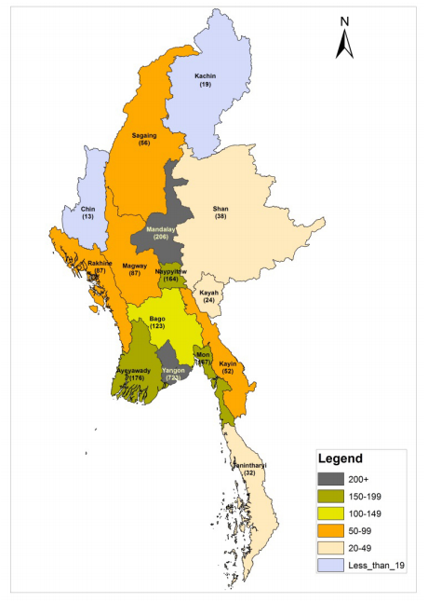
Section 3: Market Potential for Payday Loan in Myanmar
Distribution of urban and rural population
70% of total population reside in rural areas with low access to internet and banking. Rural population relies heavily on pawn shops and informal money lenders as microfinance institutions also have limited reach to the customers.
The distribution of rural population takes place around 70% of the total population in Myanmar.
Yangon, the capital, makes up around 14% of the whole country population with 70% urbanization and 30% rural proportion. Mandalay follows Yangon in terms of population density.
Figure: Map of Myanmar by Population Density
Urban (Enumerated) Myanmar
Rural (Enumerated) Myanmar
Male
7,112,105
Male
17,113,199
Female
7,752,014
Female
18,235,749
Source: Provisional Results of The Population and Housing Census of Myanmar, 2014

Slide 45
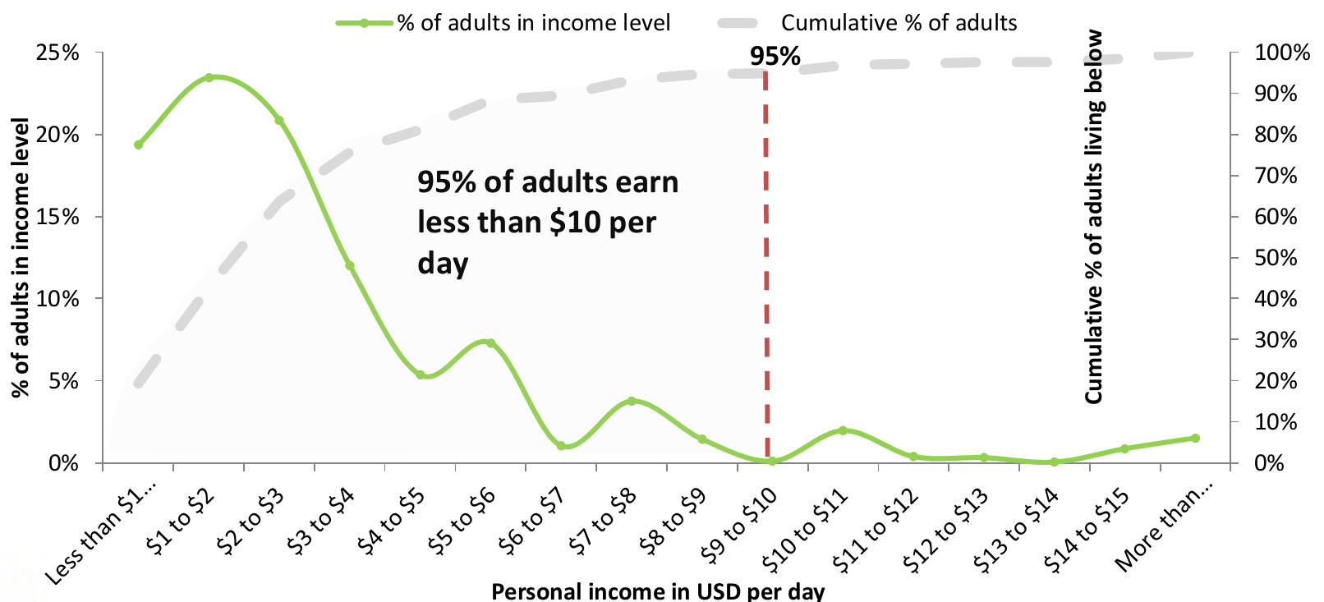
Section 3: Market Potential for Payday Loan in Myanmar
Analysis of population income and target market for PDLs
According to a survey of 30,486,972 adults conducted by Cenfri, UNDP and LIFT, 95 percent of the population earns less than USD 10 a day while nearly 25 percent of the population earns between USD 1 to 2 a day.
Majority of the population, according to the presented figure below, requires better access to financial services.
N = 30,486,972 adults
Source: MAP Report

Slide 46
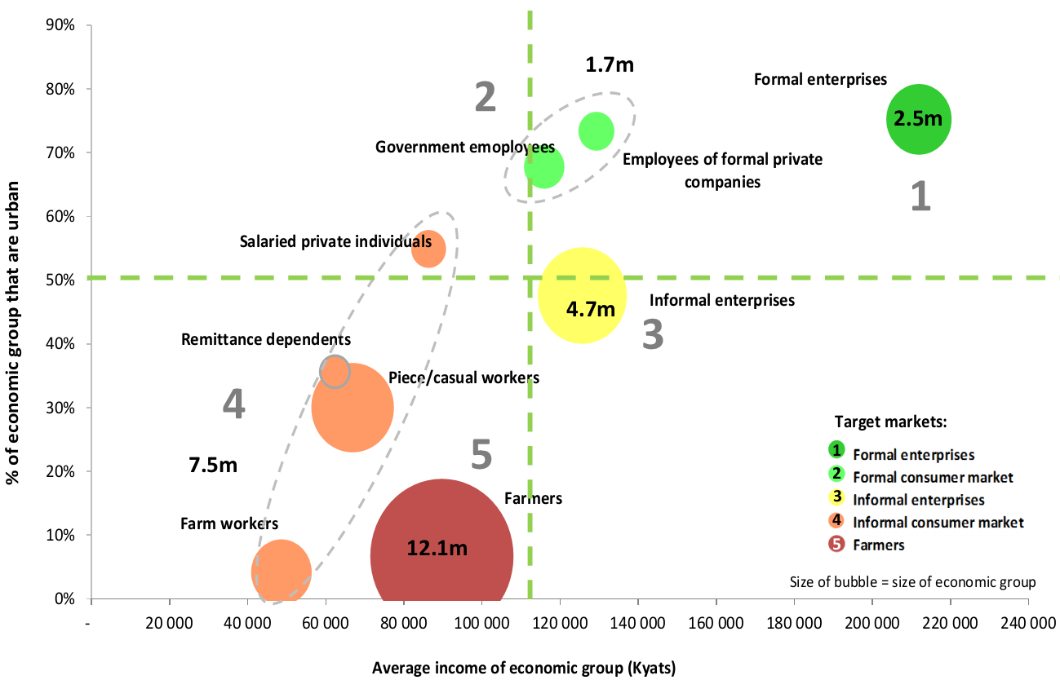
Section 3: Market Potential for Payday Loan in Myanmar
Analysis of population income and target market for PDLs
There are five discrete target markets for payday loans in Myanmar.
These are formal enterprises, formal consumer market, informal enterprises, informal consumer market and farmers.
Farmers make up the largest market share with 12.1 million people followed by informal consumer market with 7.5 million people.
Average income of farmers is between 80,000 to 100,000 kyats. Informal consumer market earns less than farmers, making it the lowest earning economic group.
Formal enterprises earn highest average income among the five groups with average income 200,000 to 220,000.
Source: MAP Report

Slide 47
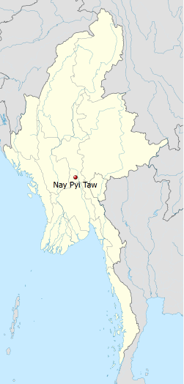
Overview of Nay Pyi Taw
Despite being the administrative hub, the isolated capital left behind other cities in terms of commercial activities. Majority of the population comprises government staffs, those whose financial needs will be greater in entry and mid level positions. However, corruption is something which needs to be considered in targeting the government staffs as majority of them have other source of earning which comes from under-table money.
In 2005, the military government officially announced the newly developed greenfield city of Nay Pyi Taw as the capital. All ministries and administrative bodies were moved to Nay Pyi Taw.
Regardless of being the capital of the city, Nay Pyi Taw lags behind other cities in terms of economic and commercial transactions as businesses remain in the former capital Yangon due to its strategic location, infrastructure and large market base. Since all administrative bodies are headquartered in Nay Pyi Taw, all businesses have to fly/drive to Nay Pyi Taw back and forth for administrative procedures.
Population | 1,158,367
Proportion of Population | 2.3%
Population Density (per sq km) | 164
No of townships in Nay Pyi Taw Region | 8

Slide 48
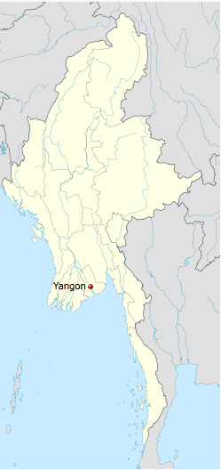
Overview of Yangon
The former capital serves the largest population. Being the economic hub of the country, Yangon’s working population consists of migrants from different parts of the country who reside in Yangon to earn a living. Being a city with largest population of regular monthly income earners and the largest ATM network, Yangon is the market with great potential to start the payday loan business.
The former capital of the country is the largest city with area of approximately 600 square kilometer.
Despite administrative hubs being relocated to the new capital, Yangon is still the economic, educational, industrial and logistics hub. Its strategic location attracts investments such as the development of Thilawa SEZ, industrial estates, ports and terminals.
Although Yangon’s infrastructure is much underdeveloped compared to other major cities of Southeast Asia, there is great room for development as investments in various sectors have been flocking with the open up of the country in 2011, ongoing reform process and increased support of international community such as lifting of sanctions to help the reform process.
Population | 7,355,075
Proportion of Population | 14.3%
Population Density (per sq km) | 723
No of townships in Yangon Region | 46

Slide 49
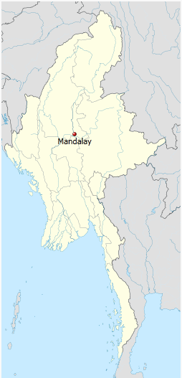
Overview of Mandalay
Being the commercial and logistics hub of Upper Myanmar, Mandalay is the second most developed and populated city after Yangon. However, the number of factories and companies are still low compared to Yangon. Furthermore, apart from migrants, most of the residents including Mandalay natives and Chinese are in the rich segment with very little financial needs. Thus, if one targets the natives for payday loans, profitability could not be as high as Yangon.
Mandalay is the second largest city after Yangon and located in Central Myanmar.
It is the second economic hub of Upper Myanmar. Due to the heavy influx of Chinese immigrants, the city’s ethnic makeup comprises the majority of Chinese and hence, increased commerce with China.
Regardless of the development of Nay Pyi Taw, Mandalay remains as the Upper Myanmar’s commercial, educational, health and logistics hub.
Population | 6,145,588
Proportion of population | 12%
Population Density (per sq km) | 206
No of townships in Mandalay Region | 30

Slide 50
Section 3: Market Potential for Payday Loan in Myanmar
Un-bankable Population
The great un-bankable population is to be reduced at first pace to meet the 20% target of bankable population set by the Ministry of Finance.
% of bankable and un-bankable population
4.8%
Banking services usage pattern is limited mostly to remittance, saving and ATM services. Money lending from banks is still limited.
The unbanked population signifies utilization of mostly unregulated financial services with a small fraction dedicated to regulated financial providers such as MFIs, pawnshops and cooperatives.
However, utilization of unregulated financial services is not limited only to unbanked population as a large fraction of the banked population also rely on unregulated sources for financing.
Being the capital of the country which offers better economic and growth opportunities, Yangon serves as a preferred destination for people all over the country to relocate and earn a living. It has the largest number of regular monthly income earners where most of them have banking access for salary payments, savings, ATM services and money transfer to their families back home.
One of the factors for low bankable population is because majority of the companies are still practicing traditional way of salary disbursements where only a few companies have switched to payment via MPU. This is one of the barriers for distribution of payday loans.
95.2%
Un-bankable population
Bankable population
Source: FinScope Report

Slide 51
Section 3: Market Potential for Payday Loan in Myanmar
Financial Needs
Financial needs exist in many clusters of rural and urban population, however, low income earners in Yangon who barely struggle to solve everyday needs could be the target market for payday loans.
Informal lending usually involves collateral requirement and while MFIs do not have such obligation, most MFI loans are disbursed by cycle. The first cycle loan amount is typically small and serve as a preliminary step to build up credit.
Payday loans may be the solution for unpredicted events which call for immediate cash payment that may be inaccessible to gain via other financial institutions.
Unforeseen risks
Emergency loans have the potential to enter the market in Myanmar as a rapid solution to unpredicted life events and natural disasters. In 2008 when Cyclone Nargis hit delta region and caused severe devastations, victims had to rely only on NGOs and government’s funding. This makes Ayeyarwaddy the region with severe financial needs until now.
Additional expenses incurred
The most common risks experienced among adults in Myanmar is the illness within family that requires medical expenses. Due to inaccessible health insurance system, most people find it difficult to source funding during these risks. Payday loans could be a solution when additional expenses are incurred i.e. buying new assets such as electronic devices, class enrollment and the like.
Everyday needs
Financial need is greater in low income earners such as factory and site workers and entry level staffs. There have been ongoing disputes between factory workers and employers over pay increase as it is getting hard to earn a living at what they get with the rising prices of goods and commodities. Minimum wage standards will be determined in a very short time but this wouldn’t make a significant difference from current rates. The common pay rate for factory workers varies from 100,000 – 180,000 Kyats.
According to reports, the following % of adults use savings or borrow money if they encounter the following common incidents.
35% - Death or illness of livestock iv. 49% - Drought, poor rainfall or loss of access to water for farming
38% - Flooding/Storms v. 53% - Harvest failure or losses
48% - Loss/failure of your business vi. 69% - Illness of family members which require medical expenses
Source: MAP Report

Slide 52
Section 3: Market Potential for Payday Loan in Myanmar
Analysis of consumer indebtedness situation in Myanmar
Therefore, the demand estimated three years ago has yet to be fulfilled while the market size have continuously developed. Additionally, the debt-to-GDP ratio in Myanmar is five per cent. There is a high demand for loans in Myanmar but low supply.
Lack of formal sources of credit – Limited number of formal sources of credit that are legally registered drives borrowers to look for other options such as informal lenders who charge higher interest rates.
Inflation – IMF’s inflation prediction for 2015 and 2016 stands at 7.8% and this rising inflation indicates that consumer indebtedness will likely be worsen as the prices of goods and services climb and borrowers have end up taking loans to afford them.
Low salary aligned with high prices of goods and services – The government has not been making effective actions to bring down the inflated prices of goods and services. Although the government has been gradually increasing salary of government staffs, there is a hike in prices of goods and services with every salary increase by the government.
Natural Disasters – Disasters could worsen the consumer indebtedness situation as victims need financing for rehabilitation and resettlement. Ayeyarwaddy and Taninntharyi Regions are mostly affected by disasters such as cyclones and tsunami.
Economy – Consumer indebtedness depends on macro and micro economic situations. For example, sudden drop in prices of rice and crops could be a situation leading to the indebtedness of farmers
Demand for loans by rural population,
UNDP 2012
USD 470 million
USD 281 million
Combined total of micro credit disbursed in 2014, UNDP
63%
% of households interviewed by LIFT in 2012 who increased their level of indebtedness
Drivers of consumer indebtedness
Source: IMF, UNCDF

Slide 53
Section 3: Market Potential for Payday Loan in Myanmar
Analysis of access to easy credit and potential for PDLs
20% % of population that uses formal financial services (Central Bank)
Most common sources of lending (LIFT survey)
Poorer households borrow for food purchase and health emergencies, whereas higher income households borrow for input purchase and business investments.
Institutions like commercial banks without a specific low-income client mandate direct capital to more lucrative opportunities in the high-income and corporate markets (for instance see commercial banks below). Although majority of the commercial banks have announced that they will extend business and individual loans with collateral, it requires someone to go through rigorous stages to apply for a loan. Banks target higher segment of the market.
Looking at the client base of MFIs, farmers make up the majority. This shows that the other segments of the population with financial needs, especially those who have regular monthly income has limited opportunity for credit.
Financial inclusion of this emergent market segment represents the biggest challenge but also the largest growth opportunity to the formal financial sector.
With the limitation that microfinance loans can be extended to just one person per household, the other household members will still have to find other sources of credit to solve their financial needs.
In addition, collateral requirement of pawnshops create opportunities for new regulated sources of credit such as payday loans.
Family, friends & money lenders
Reasons for borrowing
Limited access to borrowing
Financial Inclusion Challenge
Source: Central Bank, MAP Report

Slide 54
Research Services in Microfinance Sector
Section 1: Myanmar Microfinance Market
Section 2: Informal Finance Market
Section 3: Market Potential for Payday Loans
Section 4: Analysis of Payday Loan Business Ecosystem
Section 5: Distribution Channel for Payday Loans
Section 6: Market Entry and Licensing
Section 7: Summary and Recommendations for Market Entry
Section 8: M&A Target Shortlisting and Their Comparative Analysis

Slide 55
Section 4: Analysis of Payday Loan Business Ecosystems
Analyze the elements of infrastructure necessary for Payday Loan
Payment: via the MPU cards
The Myanmar Payment Union (MPU) was established in 2011 as the first ATM payment system in Myanmar. With 18 member banks (15 private and 3 state-owned), it offers support for Visa, MasterCard, China Union Pay Card and such. The first ATM started operations in 2012. There are about 900,000 MPU Card holders nationwide. Currently, ATMs allow limited function of withdrawal only.
If one decides to handle distribution and payment collection via MPU card, he or she might be forced to serve a very limited portion of the population. ATMs can be mostly seen around the key areas of a city. Though they can be located in main hubs like Yangon and Mandalay, rural areas remain ATM-less.
Payment collection MPU card may still take a few years to come into existent. There are banks that allow fund transfer via ATMs; Asia Green Development Bank, Ayeyarwaddy Bank, CB Bank and United Amara Bank – the banks which have the largest ATM network after Kanbawza Bank.
ATMs can be used with Visa, Master Card, China Union Pay, Japan Credit Bureau cards etc.
The use of ATMS as a distribution channel offers convenience, ease of use and security in receiving loans and making repayments.
Although the ATM network and the number of card holders are growing, several users are experiencing technical difficulties and system errors during operation.
Source: MPU

Slide 56
Section 4: Analysis of Payday Loan Business Ecosystems
Analyze the elements of infrastructure necessary for Payday Loan
Collection Agency
There is no collection agency in Myanmar. MFIs are now operating with loan officers who are responsible for distributing and collecting credit. Pawnshops have the offices where the money borrowers have to come and make the payment. Illegal money lenders also collect the money in convenient ways agreed with their borrowers.
The fact that there is no act or regulation governing debt collection agencies is another factor that restraints the use of collection agencies since specific regulations or practices are to be prescribed to make sure that collection agencies operate within the legal boundaries. Without any legal enforcement, collection agencies may use ways which can negatively impact client relations.
Factors to be taken into consideration
1
2
3
Risk in Client Relations
Impact on Reputation
High Cost
Hiring a third party as the collection agency is definitely going to cost more than collecting the money on its own.
The method of collecting money to be used by the third party might not always be as gentle as a customer expects. Thus, that could be one setback as it can destroy the client relations.
Since payday loan is very new to the market, the lender needs to build strong and good reputation and should avoid the risk that misconduct or negative behaviors of collection agency could be vulnerable to the lender.
Example
Cooperatives have used some ones from the village or townships to act as agents in disbursing and collection loans of their cooperative financing program. However, the system has failed in some parts of the country due to credibility of the agents.

Slide 57

Section 4: Analysis of Payday Loan Business Ecosystems
Availability of resources on an outsource basis
Call Center
Blue Ocean Contact Center, which is also known as the first Call Center in Myanmar, run 24x7x365 for its customers and corporate businesses. Serve the public by one stop information sharing service and provide Call Center services to its client.
Client agree to a one year contract term
Client must provide training to call center agent one month prior to operation
Client must agree to pay 50 percent down payment at the time of contract, the rest of payments can be made monthly.
Call center assures to provide agents who are university-graduates, well-trained and experienced. Client will be able to select amongst available agents.
As standard system for hotline, incoming calls will be answered instantly by any available agent. If the client wishes to incorporate interactive voice recording such as forwarding to appropriate agent who specializes in certain category, there will be additional charges than the listed fees in the next page. These charges will be discussed in detail prior to signing of contract.
Call center has assigned supervisors who will be keeping track of clock in-and-out time of agents and ensure they are working properly.
Call center agents will be responsible to data management and directing call recordings to client at prescribed time intervals.
Source: Blue Ocean

Slide 58
Section 4: Analysis of Payday Loan Business Ecosystems
Availability of resources on an outsource basis
Call Center Outsourcing Price List (Monthly)
No | Description | Price (KS) | Remark
1 | 7 digits (2399xxx) | 300,000 | Seven Digit Hotline Number
2 | Per Seat Rental Pricing | 250,000 (8 Hrs)
 |  | 500,000 (24 Hrs)
 |  | 350,000 (16 Hrs)
 |  | 300,000 (12 Hrs)
3 | Call Center Agent (8hr Shift) | 180,000 | Must hire an additional call center agent who will be responsible to take in place of call-out and leave of other agents.
4 | Team Leader | 250,000 | Manage the team of call center agents. Overtime for team leader is 3,000 Ks (Per hour)
5 | Internet Service Per Seat | 15,000
6 | Database Management Report | 150,000 | Will be necessary to manage call recordings
7 | Server Hosting | 150,000 | Mandatory
Source: Blue Ocean

Slide 59
Research Services in Microfinance Sector
Section 1: Myanmar Microfinance Market
Section 2: Informal Finance Market
Section 3: Market Potential for Payday Loans
Section 4: Analysis of Payday Loan Business Ecosystem
Section 5: Distribution Channel for Payday Loans
Section 6: Market Entry and Licensing
Section 7: Summary and Recommendations for Market Entry
Section 8: M&A Target Shortlisting and Their Comparative Analysis

Slide 60
Section 5: Distribution Channels for Payday Loans
Distribution channels for existing lenders
MFI
Loan officers disburse and collect loans in person.
Some MFIs appoint one of the locals as a representative who collect debt on their behalf.
In some cases where borrowers live in remote area with difficult transportation access, someone in charge of ward/village administrative councils will collect the payment on behalf of loan officers. However, the person must be of high credibility.
Pawnshops
Both disbursement and repayment of loans take place at the pawnshop.
Informal Money Lenders
Disbursement and repayment of loans are done by lender himself or agents who are employees or family members of the lender.
NGOs and Cooperatives
Both NGOs and cooperatives adopt traditional distribution methods in loan disbursement and debt collection.
Since the reach of ATM and fund transfer over the MPU cards is still limited, lenders still rely on traditional way of doing loan transactions manually. However, if technological and infrastructural developments are to take place, lenders are likely to adopt more efficient distribution pattern and channels.
Mobile money is still in very infant stage where only two have been officially launched and the rest being in development stage. If mobile money shows satisfactory results, some of the MFIs might switch to it to cut distribution costs.
However, some of the MFIs show reluctance in switching modern distribution technique as they want to maintain close contacts with borrowers and the traditional distribution method allows them to check borrower’s business progress and living conditions if they improved after receiving the loan.

Slide 61
Section 5: Distribution Channels for Payday Loans
Assessing possible distribution models : Option A - via MPU
The below illustrates the distribution methods and channel that could adopt in conducting payday loan business in Myanmar.
Distribution
Lender’s Current Account
Transfer
Borrower’s MPU account
Lender’s account (Saving/Deposit)
Borrower’s MPU account
Repayment
Bank deducts the outstanding amount and deposit to
Borrower’s MPU account (after salary has been processed)
1
Borrower’s MPU account (after salary has been processed)
Lender’s MPU account
This works only if salary is paid directly to employer’s MPU account. The bank can deduct from borrower’s salary only with the consent of the borrower.
Borrower manually deposit the amount due to his MPU account
Bank deducts the outstanding amount and deposit to
2
Salary payment in cash
Borrower’s MPU
Lender’s Current Account
With the approval of the account’s owner, the bank can deduct directly from borrower’s account.
This requires agreement with the bank as bank plays an important role as an intermediary in every transaction.
The number of employers disbursing salaries through MPU is yet to be improved as it is still low and almost 90 percent is concentrated in Yangon.
Success of this model relies heavily on the penetration rate of MPU cards which covers only a portion of population in major cities like Yangon, Mandalay and Nay Pyi Taw.

Slide 62







Section 5: Distribution Channels for Payday Loans
Assessing possible distribution models : Option B- via mobile money platform
Partnering with an existing mobile money platform could also be an option for distribution channel. Myanmar Mobile Money is the only operator that received a license to operate in the country so far.
Foreign mobile operators such as Ooredoo and Telenor are very eager to work as mobile money providers but may not receive the license any time soon as the Central Bank does not look easy on approving license to mobile operators. According to stakeholders from mobile money sector, the telcos have not yet started any concrete action since they are struggling with their infrastructural developments.
Firms in preparation to enter the mobile money business
Telenor and Yoma Bank have announced that they will work together in developing a mobile money platform and serve those in need of credit.
Ooredoo will form a partnership with either AYA Bank or CB Bank. It is also possible that Ooredoo could stand as solo provider as well.
myKyat was supposed to provide the full service in the early 2015 but due to some circumstances, the service will not be available until some time. Agents location and services available will be announced at the same time.
There is another potential mobile money operator called Speed Kyat which is also another branch of Internet wallet.
Speed Kyat will initially focus on mobile money business and after that, it might be considered as mobile payment platform for loan disbursement and collection of Internet Wallet.
Speed Kyat refuse to disclose the application modules and agent networks since they are still in the development stage.

Slide 63


Section 5: Distribution Channels for Payday Loans
Myanmar Mobile Money
Myanmar Mobile Money
Under the umbrella of the military-run Myanmar Economic Corporation (MEC), Myanmar Mobile Money is the first to open in the country in collaboration with Innwa Bank, a subsidiary of MEC.
MMM was established with the direction of Commander-in-Chief Senior General Min Aung Hlaing with the intention of developing infrastructure, reducing poverty and raising the lives of the poor. MMM operates in a model of 50% for profit and 50% for development.
Launched at the beginning of 2014. MMM has now 55,026 customers countrywide and 528 agents in total. MMM works only with MPT and MEC Tel, the two largest market share holders. It is now in talks with Telenor and Ooredoo to
The platform uses technology from More Magic – USA and Oberthur – France. Following international practices and working with the world’s most secured and advanced technology companies, MMM guarantees the security of customers’ accounts and every transaction.
Flow of funds into account
Link the phone to an account Cash deposited with an agent Money transferred from another account Salaries sent to the phone
Services Available
Cash in Cash out P2P Transfer Top Up Purchase Salary Disbursement
Flow of funds out account
Withdraw cash from an agent Pay for goods and services (web, in store, bills, airtime, etc) Send money to others (remittances) Savings, health insurance, etc
Source: Myanmar Mobile Money

Slide 64
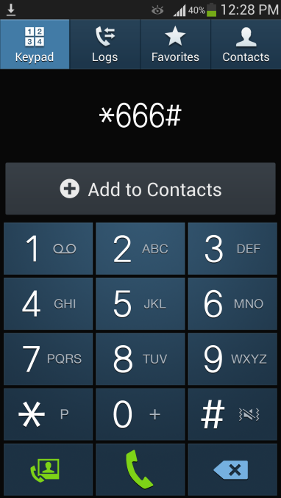
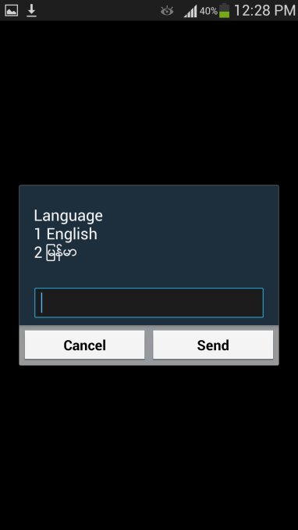
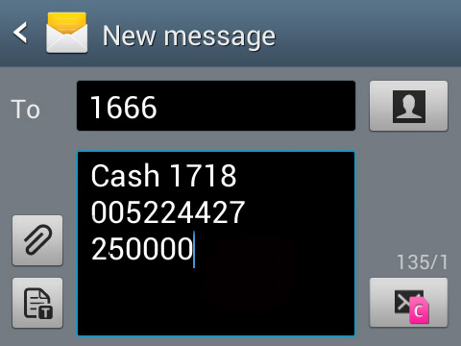
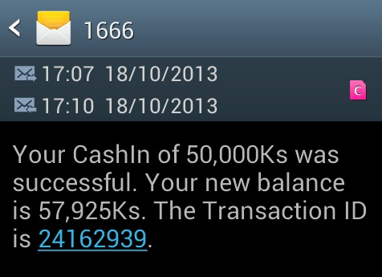

Section 5: Distribution Channels for Payday Loans
Mediums used by Myanmar Mobile Money (MMM)
1
USSD
2
SMS
3
Mobile Apps
There are three types of functions available to use mobile money via Myanmar Mobile Money.
USSD
SMS
Mobile Apps.
SMS service is widely used by the customers since people from rural areas are not very familiar with USSD and mobile apps systems. Thus, SMS is also considered as main medium for microfinance services.
Source: Myanmar Mobile Money

Slide 65
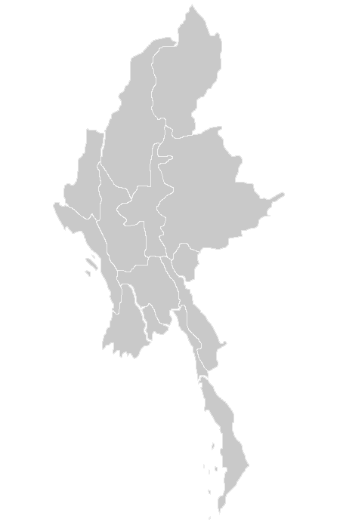
Section 5: Distribution Channels for Payday Loans
Myanmar Mobile Money Platform (Agents Location)
Chin
Sagaing
Kachin
Mega Agent:
Super Agent: -
Agent: -
Sub-Agent: 1
Merchant: -
Super Agent: 5
Agent: 18
Sub-Agent: 6
Merchant: 20
Mega Agent:
Super Agent: -
Agent: 2
Merchant: -
Shan
Mega Agent:
Super Agent:
Agent: 8
Sub-Agent: 5
Merchant: 4
Mandalay
Magwe
Mega Agent:
Super Agent: 13
Agent: 35
Sub-Agent: 5
Merchant: 11
Mega Agent:
Super Agent: 2
Agent: 6
Sub-Agent: 23
Merchant: 2
Rakhaing
Naypyidaw
Mega Agent:
Super Agent: 1
Agent: 5
Sub-Agent: 1
Merchant: 3
Kayah
Mega Agent: 1
Super Agent: 4
Agent: 12
Sub-Agent: 6
Merchant: 11
Mega Agent:
Super Agent: -
Agent: 1
Sub-Agent:
Merchant: 1
Yangon
Mega Agent: 2
Super Agent: 28
Agent: 44
Sub-Agent: 55
Merchant: 78
Bago
Mega Agent:
Super Agent: 2
Agent: 4
Sub-Agent: 6
Merchant: 5
Mon
Kayin
Mega Agent:
Super Agent:
Agent: 2
Sub-Agent: 1
Merchant: -
Mega Agent:
Super Agent: -
Agent: 3
Sub-Agent:
Merchant: 2
Ayeyarwaddy
Tanintharyi
Mega Agent:
Super Agent: 4
Agent: 32
Sub-Agent: 4
Merchant: 9
Mega Agent:
Super Agent: 1
Agent: 2
Sub-Agent: 4
Merchant: 1
Source: Myanmar Mobile Money

Slide 66
Section 5: Distribution Channels for Payday Loans
Myanmar Mobile Money Eco System
Innwa Bank
Myanmar Mobile Money
Agent Deposits Amount
Mega Agent: Above 100,000 USD
Super Agent: 25,001 USD to 100,000 USD
Agent: 5,001 USD to 25,000 USD
Sub-Agent: 2,001 USD to 5,000 USD
Merchant: 300 USD to 2,000 USD
** Deposit payment is to be made to its partner, Innwa Bank.
Mega Agent
Super Agent
Agent
Sub-Agent
Merchant
Customer
Customer
Customer
Customer
Customer
Source: Myanmar Mobile Money

Slide 67
Section 5: Distribution Channels for Payday Loans
Myanmar Mobile Money Eco System
Available Transaction | Amount | Fees
New Account Opening (KYC) |  | 500(Goes to Agent)
Monthly Fees
Money Transfer | Min | Max | Fees
P2P Transfer (Register User) The fees go to MMM | 1,000 Ks / 1 USD | 50,000 Ks/ 50 USD | 80 Ks/ 8 Cents
 | 50,001 Ks/ 50.1 USD | 100,000 Ks/ 100 USD | 120 Ks/ 12 Cents
 | 100,001 Ks/ 100.1USD | 200,000 Ks/ 200 USD | 160 Ks/ 16 Cents
 | 200,001 Ks/ 200.1 USD | 500,000 Ks/ 500 USD | 400 Ks/ 40 Cents
Cash Out (Register User) The fees go to agents | 1,000 Ks / 1 USD | 5,000 Ks/ 5 USD | 120 Ks/ 12 Cents
 | 50,001 Ks/ 50.1 USD | 100,000/ 100 USD | 180 Ks/ 18 Cents
 | 100,001 Ks/ 100.1USD | 200,000/ 200 USD | 240 Ks/ 24 Cents
 | 200,001 Ks/ 200.1 USD | 500,000/ 500 USD | 400 Ks/ 40 Cents
 | 500,001 Ks/ 500.1 USD | 10,000,000/ 1000 USD | 800 Ks/ 80 Cents
P2P Tansfer + Cash Out (Unregister User) | 1,000 Ks / 1 USD | 20,000 Ks/ 20 USD | 400 Ks/ 40 Cents
 | 20,001 Ks/ 20.1 USD | 50,000 Ks/ 50 USD | 800 Ks/ 80 Cents
 | 50,001 Ks/ 50.1 USD | 100,000 Ks/ 100 USD | 1,200 Ks/ 1.2 USD
 | 100,001 Ks/ 100.1USD | 200,000 Ks/ 200 USD | 2,400 Ks/ 2.4 USD
 | 200,001 Ks/ 200.1 USD | 500,000 Ks/ 500 USD | 4,800 Ks/ 4.8 USD
Salary Disbursement
Pension Providers |  |  | 50
Employers |  |  | 100
Inbound Salary Distributors |  |  | 500
Top-up |  |  | Free
Pin Change |  |  | 200
Balance Inquiry |  |  | Free
Account History |  |  | Free
Cash In |  |  | Free
Source: Myanmar Mobile Money

Slide 68
Section 5: Distribution Channels for Payday Loans
Operating as Mega Agent or Super Agent
can apply for either Mega Agent or Super Agent to begin the payday loan services.
Mega Agent or Super Agent
can hire people to work as agents in certain locations and they will be paid monthly salary but commission fees is an option. In this case, must put the deposit for each agents.
Agents have the right to limit the services they offer such as top up, cash in, cash out.
They can also limit their customers by only serving payday loan borrowers.
Mega Agent/Super Agent can connect directly with the customers or via agent.
Agent
Customer
can work with customers with or without agents. However, it seems more convenient and less complicated to have agents in between. Customer can register at the nearest agent and apply for the payday loans and cash out at the same place if granted. The certain amount of money will be deducted from the customer account once the loan period is over. In order to do so, customer must have enough money in his/her e-wallet or they have to be paid salary via mobile money which is still a very rare case in Myanmar. Thus, the customer will have to go back to agent and change the money into virtual cash and make the payment. The transaction between agent and mega agent/super agent can be handled in any convenient way agreed upon both parties.
Source: Myanmar Mobile Money

Slide 69
Section 5: Distribution Channels for Payday Loans
Case Study – Pyae Mahar MFI
Customer can go to the nearest agent/ loan officer and apply for the loan.
Report to the super agent if the loan is granted or repaid.
Customer
Agent/ Loan Officer
Mega Agent or Super Agent
Customer also goes to agent/ loan officer to return the loan.
Loan Officer checks the criteria and decides whether to approve the loan or not.
Loan Officer also accepts the loan returns.
Pyae Mahar Microfinance institution is operating according to this module. In this case, the microfinance institution puts their loan officers as agents and that way, the loan process can take place faster since the loan officers are authorized to disburse money on their judgment.
We have not discussed with Pyae Mahar about their feedback on the module but what it looks like is that every transaction has to be handled manually and that could be a barrier.
Source: Myanmar Mobile Money, Pyae Mahar

Slide 70



Section 5: Distribution Channels for Payday Loans
myKyat – Mobile Money
Another licensed player in the mobile money sector is myKyat which is still in the development of its platform to start full operations soon.
myKyat is a JV firm between Singapore based Frontier Technology and First Private Bank.
myKyat operates under the license issued by the Central Bank of Myanmar to First Private Bank Limited.
The platform is powered and supported by SAP technology.
myKyat services will be only available via MPT network but myKyat says they are in talks with Telenor and Ooredoo although there is
myKyat is in talks with Ooredoo and Telenor for the use of their mobile networks but it is not certain that they will reach an agreement any time soon since the mobile operators are hesitant to provide USSD networks.
myKyat was supposed to have the full launch in the early 2015 but due to some issues on the bank side, the service will not be available until late April.
Since agent network is being built up at the moment, their locations and services available will only be announced in the end of April or even later.
Source: myKyat

Slide 71
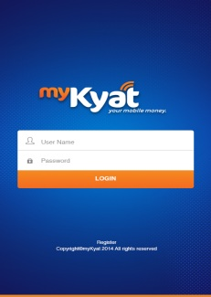
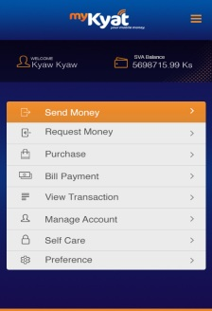
Section 5: Distribution Channels for Payday Loans
Mediums used by myKyat
1
USSD
2
SMS
Dial *661# from Registered Mobile Number
Send SMS message
“pin SEND mobile amt message”
to 1661 from your mobile
3
Mobile Apps
There are three types of functions available to use mobile money via myKyat.
USSD
SMS
Mobile Apps
myKyat expects customers to use USSD mainly because most of them are not familiar with mobile apps and it is costly to use sms.
Source: myKyat

Slide 72

Section 5: Distribution Channels for Payday Loans
Operating as a Business User
Business User
Sub-Business User
Sub-Business User
Sub-Business User
Customer
Customer
Customer
Customer
Customer
Customer
In this model, can apply for business user via Bank or Agent to set up a microfinance network.
A business user can have the sub business users under its network and connect with consumers via them.
The business user is to put the certain amount of money into the bank or agent that they want to transfer. And the business user can send the virtual money into the sub-business users’ accounts.
A customer can open a myKyat account via SMS, USSD or Mobile App.
And the customer can apply for loan/cash-in/cash-out at nearest sub-business user.
Customer can text the business users’ phone numbers to request money as well.
Every user can check the transaction online everyday via portal: https//portal.myKyat.com
Source: myKyat

Slide 73
Section 5: Distribution Channels for Payday Loans
Mobile Penetration in Myanmar
Mobile Penetration and Mobile Internet Usage
Myanmar’s mobile penetration rate grew at a first pace from 27% in 2013 to 34% in 2014.
The number of mobile internet users reached 2.65 million as of May 2014.
Network | Operator | No of users | % share
GSM | MPT, Telenor | 1,870,000 | 71%
CDMA 800 MHz | MPT | 350,000 | 13%
CDMA 800 MHz | MEC | 330,000 | 12%
WCDMA | MPT, Ooredoo, Telenor | 100,000 | 4%
Fixed landline connections have grown to 11.6 million as of September 2014 from 1.64 million in 2010-2011FY.
MPT has the largest market share in terms of mobile and internet penetration. It also has the most infrastructure compared to the new comers, Ooredoo and Telenor. It has teamed up with Japan based KDDI which is a strategic alliance as MPT’s infrastructure and KDDI’s technology will enhance the competence of the team against the other operators.
However, being the most expensive operator in terms of mobile usage and data plan, a large portion of its users has switched to Telenor and Ooredoo.
Comparing the two new entrants, Telenor has slightly more users as it provides both 2G and 3G networks while Ooredoo only offers 3G which works on high model handsets only.
Source: MPT

Slide 74
Section 5: Distribution Channels for Payday Loans
Mobile Penetration in Myanmar
Mobile Penetration as of Dec 2014
Total no of SIM cards sold
MPT
MEC Tel
Ooredoo
31.5% Mobile Penetration in 2014
Telenor
11,565,000 – Dec 2014
There are currently three mobile providers, state-owned Myanmar Post and Telecommunication (MPT), Ooredoo and Telenor.
MPT is the premier telecommunication provider in Myanmar and played monopoly in the market for many years until mid 2013 when Telenor and Ooredoo were granted nationwide telecom licenses. The state-run operator has formed an alliance with Japanese operator, KDDI, who was in the competition for the two nationwide licenses in 2013.
MEC Tel, a subsidiary of military-back Myanmar Economic Corporation (MEC), as a sub-contractor to MPT.
1,050,000 - June 2013
1,600,000 - Dec 2014
2,000,000 – Dec 2014
Source: MPT, MEC

Slide 75
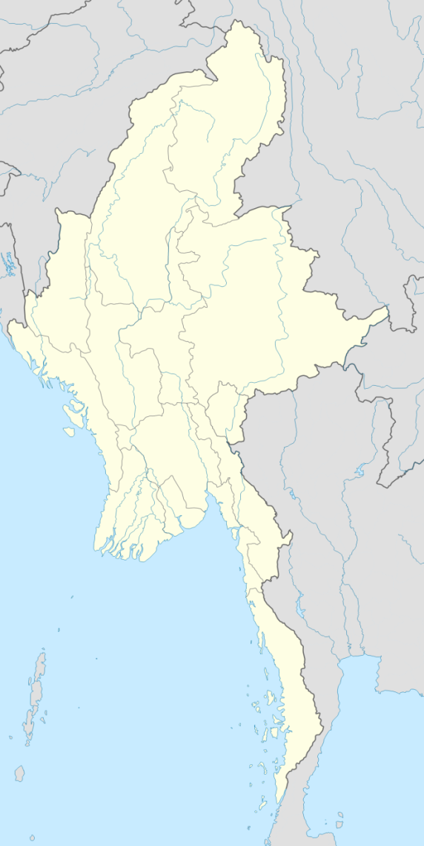
Section 5: Distribution Channels for Payday Loans
Mobile Network Coverage, MEC
Number of MEC SIM Cards Sold and its Market Share in 2013 (April 2013 to June 2013)
Kachin: 11,000 (1.04%)
MEC Tel has started selling SIM cards since 24 April 2013. The map shows the total number of SIM cards that were sold during April 2013 to June 2013.
As expected, Yangon has the most MEC Tel Customers with 24 percent of total SIM cards were sold in the city followed by Mandalay and Ayeyarwaddy for 19 percent and 10 percent respectively.
Kayah State has the least amount of MecTel users as only 0.18 percent of SIM cards were sold in the isolated state.
The total amount of sim cards sold by June 2013 is 1,050,000 that almost matched the targeted number which is 1,076,500.
Sagaing: 45,900 (4.36%)
Mandalay: 205,200 (19.54%)
Shan: 83,700 (7.95%)
Chin: 5,000 (0.46%)
Rakhine: 10,480 (0.98%)
Naypyidaw: 45,000 (4.27%)
Magwe: 67,600 (6.43%)
Kayah: 2,000 (0.18%)
Bago: 97,617 (9.28%)
Kayin: 21,100 (2%)
Yangon: 306,508 (29.18%)
Mon: 30,600 (2.91%)
Thaninthayi: 7,200 (0.85%)
Ayeyarwady: 111,095 (10.57%)
Source: MEC

Slide 76
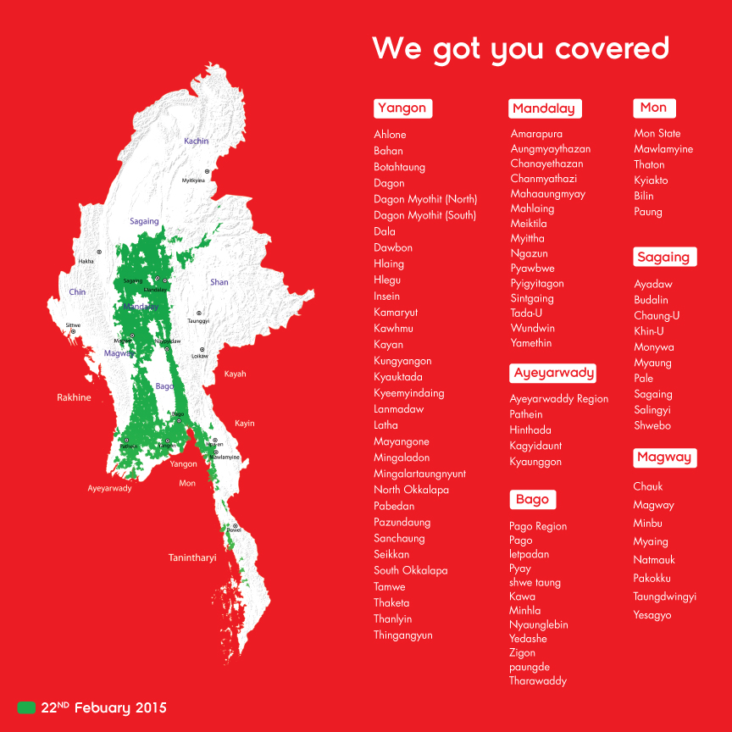
Section 5: Distribution Channels for Payday Loans
Mobile Network Coverage, Ooredoo
The Qatar based mobile network operator (MNO) gained nationwide operating license from the government in June 2013.
The MNO got telecom license together with its competitor, Telenor. However, Ooredoo gained first mover advantage in terms of issuing SIM cards and distributing to the public.
Ooredoo provide the mobile services at the rate of 25Ks/2.5 Cents per minute and sms at 15Ks/1.5 Cents. And the internet services begin from 10Ks/1 Cent per minute.
Among mobile operators, Ooredoo stands as the second most expensive operator behind MPT and followed by Telenor.
Source: Ooredoo

Slide 77
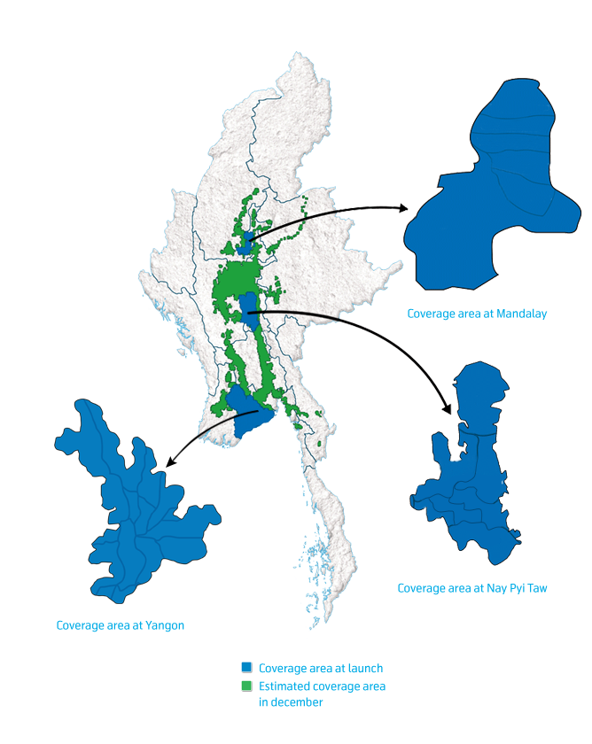
Section 5: Distribution Channels for Payday Loans
Mobile Network Coverage, Telenor
The Norwegian mobile network operator (MNO) gained nationwide operating license from the government in June 2013 together with Ooredoo.
The mobile network was launched in September 2014 and is expected to cover 90 % of the population within 5 years. So far, of sim cards have been sold.
Telenor provides the mobile services at the same rate with Ooredoo which include 25 Kyats/ 2.5 Cents per minute and 15 Kyats/ 1.5 Cents per SMS. Internet plan begins at 6 Ks/ 1 MB.
Telenor is currently the cheapest operator in the country and it could be a significant factor in reaching their goal of 90% coverage in 2019.
Source: Telenor

Slide 78
Research Services in Microfinance Sector
Section 1: Myanmar Microfinance Market
Section 2: Informal Finance Market
Section 3: Market Potential for Payday Loans
Section 4: Analysis of Payday Loan Business Ecosystem
Section 5: Distribution Channel for Payday Loans
Section 6: Market Entry and Licensing
Section 7: Summary and Recommendations for Market Entry
Section 8: M&A Target Shortlisting and Their Comparative Analysis

Slide 79
Section 6: Market Entry and Licensing
Market Entry and Licensing
Licensing Procedures
Registering as a Company
Starting from registering as a company, the intended MFIs have to register at the following ministries.
Type of company | Department | Ministry
Profit taking companies | National Planning and Economic Development Department | Ministry of National Planning and Economic Development
 | Directorate of Investment and Company Administration
NGOs and INGOs | General Administration Department | Ministry of Home Affairs
Cooperatives | Cooperative Department | Ministry of Cooperatives
Operating License
License application as instructed (MFI-01)
No expiry date on license
The license is not transferable
If a MFI wants to expand its services to areas it has not been permitted, applications are to be made to Financial Regulatory Department.
Source: Financial Regulatory Department

Slide 80
Section 6: Market Entry and Licensing
Market Entry and Licensing
Licensing Procedures
Requirements in license application
Company registration
Categorization of institutions
Profit management
Date of company establishment
Capital injection (original receipt)
Source of capital
Intended operation location
Number of clients (initial) (After conducting surveys and feasibility study in proposed areas, the number of potential borrowers is to be proposed.)
Article of association and memorandum of association
Feasibility study
Senior management experience
Parent company’s BOD decision
3 years business plan
Relevant microfinance committee’s approval
For foreign companies Capital flows from parent company (cash in from abroad) Parent company’s BOD decision to operate as MFI Parent company’s financial statement
Source: Financial Regulatory Department

Slide 81
Section 6: Market Entry and Licensing
Market Entry and Licensing
Licensing Procedures
Application Process for a license to operate as a MFI
1.
Feasibility Study
a) | Description of location to be carried out microfinance, existence of market and having interest of the community concerned. Location must be equally distributed between rural and urban geographical areas.
b) | The financial resources required and how they may be acquired
c) | Expected benefit to be obtained if the microfinance is carried out and the arrangement to manage the benefits
d) | Management qualification and skill
e) | Types of microfinance desirous to be carried out
2.
Categorization
a) | Non-deposit taking microfinance institution
b) | Deposit taking microfinance institution
Source: Financial Regulatory Department

Slide 82
Section 6: Market Entry and Licensing
Market Entry and Licensing
Licensing Procedures
Application Process for a license to operate as a MFI
3.
Paid-up Capital
a) | Subscribe the paid-up capital in cash | For non-deposit taking institutions 15 million kyats For deposit taking institutions 30 million kyats
b) | Deposit the fully paid-up capital to the accounts of the Financial Regulatory Department at the prescribed Myanmar Economic Bank in the respective Region or State and Nay Pyi Taw. Such paid-up capital shall be entitled to withdraw only the completion of issuing license from the Supervisory Committee.
4.
Business Plan
a) | Three year Business Plan must be submitted along with license application.
5.
Meeting with Financial Regulatory Department
a) | Head of the company must meet with Financial Regulatory Department to receive assessment of knowledge and capacity regarding Microfinance sector.
Source: Financial Regulatory Department

Slide 83
Section 6: Market Entry and Licensing
Market Entry and Licensing
Licensing Procedures
Timetable to finish the whole application process
After issuing licenses for 217 MFIs, Myanmar Government will soon be restricting the number of license issued.
Out of 217 MFIs, there are only few of them which are actively operating with a company structure while most of them only operate as a very small sized firm just to disguise their pawn shops or lending activities.
The timeline described below is an average time consumption for the license application process, however; the accurate timeline depends on the individual applicants which varies from 1 month to even 2 years.
Preparing documents and 3-year business plan
1 month
1 month
To get license
Must initiate operation within 6 months.
Temporary License
Surveying selected territories
1 month
Meeting with Ministers in Nay Pyi Taw
15 days
After receiving the temporary license, the MFI must start operations within 6 months and actual license will be granted within a year. However, if one fails to show satisfactory performance during that period, FRD will not consider granting the license.
Source: Financial Regulatory Department

Slide 84
Section 6: Market Entry and Licensing
Market Entry and Licensing
Licensing Procedures
Scoring system for Microfinance Operation License
Microfinance Regulatory Department meets once a month to review submitted MFI applications by assigning scores to each applicants in terms of the following components. The applicant must score at least 60 or above to get the MFI license.
Equal Ratio of Urban and Rural Locations
Institutional Framework
25%
25%
60/100
Social Activities
Interview with Minister of Finance
25%
25%
Source: Financial Regulatory Department

Slide 85
Section 6: Market Entry and Licensing
Capital Requirement in Microfinance Sector
Licensing Procedures
Minimum capital requirement to invest in microfinance sector
Paid-Up Capital
Non-deposit taking institution | 15 million kyats
Deposit taking institution | 30 million kyats
According to the Notification No. 1/2011 released by Financial Regulatory Department, there are further guidelines on interest rate, application fees and license fees aside from paid-up capital.
Application Fees
70,000 kyats for the establishment of a branch office, the transfer of the place of business and the termination of the business*
Type of business (non-deposit taking institution/deposit-taking institutions) 50,000 kyats for changing the type of business
License Fees
a) | Initial license fee: 0.1% of the paid-up capital (within 15 days from the date of license issued)
b) | License fee for increase in paid-up capital: 0.01% of the capital increase
c) | Annual license fee: 0.1% of the paid up capital (in April of the year)
Note: For transfer from one township to another, Financial Regulatory Department will specify whether an application fee has to be paid; no application fee has to be paid for transferring the place of business within the same township.
Source: Financial Regulatory Department

Slide 86
Section 6: Market Entry and Licensing
Market Entry and Licensing
Information regarding to joint-venture in microfinance sector
The government allows 100% foreign ownership in Myanmar Microfinance sector.
The following table shows the required documents in applying for a JV company at Directorate of Investment and Company Administration.
Required Documentations for Establishing a Joint Venture Company in Myanmar
Application letter to concerned Ministry if the Shareholder is National Government
Memorandum and Articles of Association
Declaration of Registration
Declaration of Registered Office
Declaration of Legal Version
Certificate of Translation
List of Directors
Specific Intended Business Activities Carrying Out by the Company (In this case, it must specifically state that it will be establishing an MFI)
Passport Copy or NRC Copy of Each Shareholder and Director and the Company Registration Certificate Copy for Each Company
Board of Director’s Resolution if Shareholder is a Company
Draft Agreement of Joint-Venture Company between the Foreigner/Foreign Company Myanmar Citizen/Myanmar Company and the Concerned Parties
Recommendation Letter of the Office of the Attorney General
Source: Financial Regulatory Department

Slide 87
Section 6: Market Entry and Licensing
Market Entry and Licensing
Permitted activities and characteristics
The microfinance institution may, with the approval of the Supervisory Committee, carry out the following function:
(a) extending micro-credit;
(b) accepting the deposit (for deposit taking institutions only);
(c) carrying out remittance;
(d) carrying out the insurance business;
(e) borrowing from the local and abroad;
(f) carrying out other financial activities.
Interest Rate
Interest Rate
%
Deposit Rate
30% Annual Effective Rate
15% Annual
Loan Size Limitation
The maximum loan size is capped at USD 5000 which was raised from previously set amount at USD 500.
Rural
Urban
50% of operations must be conducted in rural areas.
50% of operations must be conducted in urban areas.
Source: In-depth interviews

Slide 88
Section 6: Market Entry and Licensing
Market Entry and Licensing
Permitted activities and characteristics
According to notification 1/2014, deposit taking MFIs must meet the instructed solvency ratio outlined below.
Note: Total Equity includes premium, donated fund, miscellaneous investments, reserved profit, reserved fund, net income, etc.
Solvency Ratio
Solvency Ratio = | Total Equity | ≥ 15 %
 | Total Assets
The notification also instructed liquidity ratio which must be kept at 30 percent minimum. The calculation formula is outlined below:
Liquidity Ratio
Liquidity Ratio = | Cash in Hand + Cash in Bank | ≥ 30 %
 | Total Voluntary Deposits Outstanding
Source: In-depth interviews

Slide 89
Section 6: Market Entry and Licensing
Market Entry and Licensing
Funding
Almost all MFIs in Myanmar are 100% equity funded from shareholders or their parent companies.
Previously, according to the microfinance law, a local MFI can only borrow funds from local bank which is Myanmar Economic Bank, a state-owned bank, however; due to obscure vision of MEB on Microfinance sector, the process of lending funds from local bank is unknown.
With the intention of creating more funding sources for MFIs, the Central Bank of Myanmar has recently enacted a regulation which allows Myanmar Microfinance Bank to finance MFIs in the form of a policy bank dedicated to the development of the MFIs rather than a commercial bank.
The financial regulatory department of Myanmar has set MFI debt financing not to exceed more than Debt to Equity ratio of 5:1.
Local | Local microfinance institutions are restricted to borrow from abroad though they can receive funding from international donors and non-profit organizations. Otherwise, local microfinance institutions are only able to borrow from state owned Myanmar Economic Bank and Myanmar Microfinance Bank.
Foreign | Foreign microfinance institutions operating in Myanmar can only borrow from abroad financial institution and are restricted to borrow from local lending institutions. The limitation amount for borrowing from abroad is set at 3 million USD. Although they are allowed to receive funding of up to USD 3 million, the debt to equity ratio is to be kept at 5:1.
Joint Venture | Joint venture firms are able to attain both sources, from local banks as well as foreign sources.
Source: Financial Regulatory Department

Slide 90
Section 6: Market Entry and Licensing
Market Entry and Licensing
Benefits
Since there is no regulation specifically drafted for payday loan at the moment, microfinance License is the most appropriate for a newcomer to enter the payday loan market in Myanmar for the following advantages.
100 Percent Ownership
Microfinance Law enacted in 2011 allows 100 foreign ownership in Microfinance Firms.
Unlimited Loan Period
The loan period is not limited by the government which offers a competitive advantage over other sources of finance.
Small Paid-Up Capital
The amount of capital needed for non-deposit taking MFI is USD 15,000 while deposit-taking is USD 30,000.
Small Paid-Up Capital
The amount of capital needed for non-deposit taking MFI is USD 15,000 while deposit-taking is USD 30,000.
One license, multiple branches
MFIs can open more than one branch by just applying a permit at FRD rather than undergoing the whole licensing process. The license is one time and does not need to be renewed.
USD 5000 Loan Cap
The maximum loan size has increased from USD 500 to 5000, which is suitable amount for emergency lending needs.
Myanmar Microfinance Bank allowed to finance MFIs
Recently, the Central Bank has enacted a regulation which allows Myanmar Microfinance Bank to finance MFIs in addition to Myanmar Economic Bank.
Mobile Payment Permitted
Directive 3/2014 stated that mobile payment system for MFI is permitted via following close directions from central bank.
Existence of payment infrastructure
Existence of payment infrastructure such as ATM network and mobile money platforms distinguish MFI from its competitors in terms of convenience, ease of use and easier data management.

Slide 91
Section 6: Market Entry and Licensing
Market Entry and Licensing
Limitations
Although microfinance license is considered to be the most appropriate license type for payday loan business, there are a few weak points which need adjustments or could be barriers in conducting payday loans.
Credit Bureau does not exist
To date, there has not been establishment of credit bureau or consumer reporting agency for microfinance sector in Myanmar. Such committee is needed to minimize hazards of extending loans to high risk individuals.
Interest Rate Cap
Payday lender needs to hold discussions with authorities to allow interest rates adjustments for the loans.
Limitations in funding
More sources of funding MFs is needed as the demand of could still not be fulfilled by Myanmar Economic Bank and Myanmar Microfinance Bank. Borrowing from these banks require collateral and Interest rate is 13% which is considered high for MFIs.
Small Paid-Up Capital
The amount of capital needed for non-deposit taking MFI is USD 15,000 while deposit-taking is USD 30,000.
Possibility to limit the number of licenses issued
According to FRD, strict measures will be imposed in granting of licenses to MFIs as there are already many players and some are not operating properly.
Limitation on target population
MFIs are instructed to serve 50:50 ratio of urban and rural population which could be a barrier as payday loan primarily target urban population who have stable monthly income. License applications of some MFIs who do not meet this criteria are being rejected.
Temporary License
Since Dec 2013, all license applicants are granted one year temporary license before the permanent license. MFIs are to start operations within a few months after receiving the temporary license and getting the permanent license depends on FRD’s judgment over the firm’s operations. Up to now, no firm has been rejected for permanent license.
Many MFIs serving a single market
The fact that government permits multiple firms to operate in the same area can create borrowers taking loans from different MFIs and piled up in debt. This is very risky for the firms for the case of bad debt. Thus, most of the firms conduct survey before serving specific areas.
General limitations
According to notification 3/2014,
No lending to purchase luxury items
No lending to more than one member of a household

Slide 92
Section 6: Market Entry and Licensing
Market Entry and Licensing
Key challenges for licensing and entry
High Interest Rate Assigned to Deposit
The interest rate assigned to Microfinance Institutions by Financial Regulatory Department for both compulsory savings and voluntary savings is 15% whereas saving deposit interest per annum is 8.25% and fixed deposit is 10% per annum(less if deposit is less than one year) for banks.
Loan Size is Capped at USD 5000
The loan size was previously capped at USD 500 and has been changed to USD 5000 due to complaints from microfinance institutions in the market. Even so, the interest income to be made at USD 5000 which will be USD 1500 at 30 percent per annum, is comparatively less when the banks lend out significantly higher loan sizes.
Banks Charge Lower Interest Rate
Though it could be seen as a good aspect that MFIs can charge higher interest rate on loans than banks, the situation could also be seen in negative light. High interest could prevent borrowers from taking a loan out of MFI.
Minor Barrier to Entry
Paid-up capital for microfinance is considerably trivial, especially for foreign firms who can contribute large amount of capital and even for local firms who cannot contribute as much. Therefore, the competitive environment can only grow larger as more firms enter the market, even those who operates as family business rather than a company add up to capture market share.

Slide 93
Section 6: Market Entry and Licensing
Market Entry and Licensing
Key challenges for licensing and entry (Contd.)
Government Intervention
Government policies outlined for microfinance sector is still unstable since the regulators are constantly establishing new directives and changing requirements. Moreover, the regulators in charge of microfinance department do not have previous experience in managing microfinance sector thus they are pursuing the learning curve as the microfinance sector flourish.
Role of Co-operatives in MFI sector
Co-operatives are ministered by both Ministry of Co-operatives and co-operative law, therefore the licensed co-operative MFIs has to abide by both the Co-operative law and Microfinance law. However, since there are conflicting clauses in different laws, some of the co-operatives decide to conduct microfinance business without applying for a MFI license. And since co-operatives were already conducting lending before the Microfinance law due to their original nature as a co-operative, the unlicensed co-operatives are not compulsory to comply with the Microfinance law.
Stability of factories and industries
Unstable condition of factories and industries that will likely occur due to the impacts of political and economic drivers is a condition that could have an impact on payday loan business as factory workers make up the primary market for payday lenders.
General Restrictions
The restriction which bars more than one person of a household from borrowing could be a constraint in payday loan business since payday loan amount of just one person may not be able to settle the financial needs of the family. The result of this could lead to household members taking credit from different sources. However, the restriction could be eased in future as financial needs are greater and the borrower’s can prove their credibility and income sources.
Restriction which limits the coverage of MFIs into 50:50 of urban and rural population could be a hindrance as most of the stable monthly income earners reside in urban areas.

Slide 94
Research Services in Microfinance Sector
Section 1: Myanmar Microfinance Market
Section 2: Informal Finance Market
Section 3: Market Potential for Payday Loans
Section 4: Analysis of Payday Loan Business Ecosystem
Section 5: Distribution Channel for Payday Loans
Section 6: Market Entry and Licensing
Section 7: Summary and Recommendations for Market Entry
Section 8: M&A Target Shortlisting and Their Comparative Analysis

Slide 95
Section 7: Summary and Recommendations for Market Entry
Key considerations for market entry
The financially soundness and profitability of the model
Sources of income
The main source of revenue for MFIs is the revenue from loan portfolio for which has two components: interest charges and fees & commissions.
Interest on loan portfolio
Fees and commissions on loan portfolio
Revenue from loan portfolio
Interest
Commission
Cash inflow
Interest rates on micro-loans signify the main income for MFIs. As MFIs in Myanmar are required to charge 30 percent effective rate per annum to clients, interest income only vary by loan product’s term and amount. Repayment structure varies such as weekly, monthly, or seasonally thus variation occurs in reception of interest income.
Commission income is generated from services such as loan processing fee and early loan redemption fee. It is generally represented as a small figure.
MFI can earn commission and transactions fees if they are disbursing the loans over the mobile money platform via their appointed agents/loan officers.
Another important cash inflow for the MFI is the compulsory savings account of a client. These saving accounts are a requirement for getting a loan. As compulsory saving is typically 1% of the loan amount, the cash inflow generated from which is nominal, and instead compulsory savings require the firm to incur interest expense issued to clients.

Slide 96
Section 7: Summary and Recommendations for Market Entry
Key considerations for market entry
The financially soundness and profitability of the model
Costs
Costs directly attributable to the micro-finance services include personnel cost and administrative and operating expenses. In general MFIs in Myanmar are rather labor intensive by which employee salaries make up the majority of most MFIs’ operating expenses thus in most cases, personnel cost is higher than administrative and operating expense. In other aspects, traveling and rental expense signify major share of administrative and operating expense. Primary source has stated 65-70 percent of total operation cost is dedicated personnel and traveling. Another source has mentioned that around 50 percent of total revenue is rental cost.
Myanmar MFIs have been struggling to achieve profitable operations, mainly due to increased salary and operational expenses. In most cases, MFIs do not generate enough revenue from loan portfolio to cover the mentioned costs within a year of operation. It can be said that bigger MFIs take even longer to generate profit such as two years of operation due to greater scale.
The cost of setting up the distribution network will also be costly although the type and amount of cost associated depends on the option. Transaction fees will be incurred when making loan disbursements.
Administrative and Operating Expenses
Distribution Expenses

Slide 97
Section 7: Summary and Recommendations for Market Entry
Key considerations for market entry
Market Perceptions
Although official figures show there are 217 licensed MFIs in the country, only some of them are operating in full functions.
According to experts, approximately 20% of the total MFIs are not operating as an MFI in which those institutions acquired license just to cover up their pawn shops or informal lending practices.
No payday lender
The market shows great potential for payday loans as it is a virgin market with no player offering the same service at the moment.
Limitations of existing players
In addition, small-sized local MFIs encounter difficulty in expanding their business across regions due to limited funding capacity and lack of information system and management capabilities to serve larger market segment.
Taking into consideration of the limitations of product offerings by MFIs, pawnshops and informal lenders, there is room for payday loan to serve the market which has been left out by the existing players.
Lack of modernization in distribution
Limited reach of banking services and the fact that mobile money is still at infant stage makes MFIs to still rely on traditional distribution model at this moment . However, if banking sector could enhance its reach and services and mobile money shows promising results, most of the players will likely adopt modernized distribution channels for better efficiency and effectiveness.
Trust based lending
The absence of Credit Bureau and FRD’s control on borrowers make MFIs to provide loans purely based on trust and a little bit background check they have performed. Thus, they carry high risk of bad debt.
Regulatory concerns
Although the market is not highly regulated, there are some weak points in the regulations such as AEON financing for luxury items.
Although FRD has imposed regulations for MFIs to abide by, it cannot regularly monitor the practices of MFIs and take effective measures to those breaching the law.

Slide 98
Section 7: Summary and Recommendations for Market Entry
Analysis of Distribution Channel
Mobile Money |  |  | MPU
Myanmar Mobile Money | myKyat | Speed Kyat
MMM has already established agent network although there are rumors that the agents are not operating fully. | Still in the process of building agent network. |  | 24/7 accessibility Widely used only in major cities, however the number of users will likely grow Limited number of ATMs except major cities
Salary disbursement function is not widely used at the moment If mobile money shows credibility and success, the function will be likely, however, will not surpass MPU for the advantages it offers. |  |  | The number of companies disbursing salaries via MPU is increasing.
No limitation as users than do both cash in and cash out at the nearest agent. |  |  | The borrower has to manually deposit cash on due date so that the lender can deduct from his account. This is not an issue for those whose salary disbursements are made to their accounts directly. Cash out is limited to USD 300 per transaction.
Both lenders and borrowers do not have to visit the bank to buy as they can easily transform the cash into e-money (virtual money) and make cash payment transaction. |  |  | This requires close interaction with the bank both for lender and borrower.
Accessibility
Salary disbursements
Cash in/out Limitation
Bank interaction

Slide 99
Section 7: Summary and Recommendations for Market Entry
Value differentiations against existing products by regulated and unregulated players
Regulated |  | Unregulated
MFIs | Pawnshops | Money Lenders
Limited reach Limited to only one member of a household Eligibility criteria (loan officers dig borrower’s financial situation, loan history) | Easily accessible with several shops in one township No strict eligibility criteria except bad record | Easily accessible within one’s community No strict eligibility criteria
Loan size cap is USD 5000 Majority of the loans is under USD 1000 | Loan size depends on valuation of collateral | No loan size cap as it varies from two digits to six digits (USD)
Interest rate cap is as determined by FRD Monthly interest rate of 2.5% for lending and 1.25% for deposits | Interest rate cap is standard rate as determined by Yangon City Development Committee Monthly interest rate of 3% for gold and 10% for others | No interest rate cap as it varies on loan size and the relationship between the lender and the borrower
Collateral taking is prohibited by law. | As its nature implies, collateral is compulsory. Pawnshops carry high risk of collateral being a stolen item or fake. | Collateral requires case to case as it varies on loan size and the relationship between the lender and the borrower.
Value
Easy Access
Loan Size Cap
Interest Rate Cap
Collateral

Slide 100
Section 7: Summary and Recommendations for Market Entry
Value differentiations against existing products by regulated and unregulated players (Contd)
Regulated |  | Unregulated
MFIs | Pawnshops | Money Lenders
Local MFIs can officially receive funding from Myanmar Economic Bank (state-owned) and Myanmar Microfinance Bank (private bank). Foreign MFIs on the other hand can take funding only from their parent companies or foreign investors/financial institutions with the approval of Central Bank. | There is no source of funding which are specifically dedicated for funding pawnshops. In case of financing needs, the pawnshops could just borrow from informal money lenders. | Informal lenders sometimes pawn borrower’s collateral at some lenders to solve their cash flow problems.
If MFIs could enhance its reach and distribution channels, there are chances that MFIs could tap larger market share and increase its profitability. By practicing group lending model, default rate of many MFIs is low and does not exceed 2%. The group lending model and limitation to just one member of a household could be hindrances in attracting more customers compared to other sources. | Pawnshops generate more money when a customer makes interest payments regularly and redeem the collateral rather than giving up on the collateral as the shops make less money when they sell the collateral back. | Profitability is high along with high interest rate. However, informal lenders carry high risks as they are not operating legally and they do not have strong legal right when a dispute occurs.
Value
Sources of debt funding
Profitability

Slide 101
Money Disbursement Agencies
Partnering with an existing mobile money platform could be an option for distribution channel. Partnering with an existing mobile money platform could also be an option for distribution channel. Myanmar Mobile Money is the only operational platform at the moment.
myKyat was supposed to provide the full service in the early 2015 but due to some circumstances, the service will not be available until some time. Agents location and services available will be announced at the same time.
Speed Kyat will initially focus on mobile money business and after that, it might be considered as mobile payment platform for loan disbursement and collection of Internet Wallet.
Below lists the three mobile money platforms which could be utilized for loan disbursement.
Company | Full Name | Position | Mobile Number | Email
Myanmar Mobile Money | Aung Aung Cho | GM (Business Planning Department) | 09420111222 | planning@myanmarmobilemoney.com technical@myanmarmobilemoney.com
myKyat | Tim Scheffmann | CEO | 09420187539 | tim@frontiertechnologypartners.com
 | Ye Lin Htet | Marketing Manager | 09795545191
Speedkyat | Ni Ni Khin | General Manager | 0943096360 | Ipay-gm@ipay-mm.com
 | Thaw Zin | Marketing Manager | 09258877770 | thawzin@speedkyat.com

Slide 102
Recruitment Agencies
Company | Full Name | Position | Mobile Number | Email
Focus Core | Eddy Herbert | Regional Sales Director Asia and Country Manager | 09259104411 | eddy.herbert@focuscoregroup.com
 | Wendy, Win Moh Moh Thant | Senior Recruitment Consultant |  | winmohmoh.thant@focuscoregroup.com
Aquila Executive Search | Chloe Williamson | Managing Director | 09255725868 | chloe@aquilamyanmar.com
 | Nathanial Hutley | Director | 011223740 | nathanial@aquilamyanmar.com
 | Erica- Kyi Sin Yu Ya | Consultant | 09250748515 | yuya@aquilamyanmar.com
Device | Wutt Hmone | Recruitment Manager | 09421007006 | recruitment@devicemyanmar.com
Executive Search Myanmar | Kay Khaing | Recruitment Manager | 0973094007 | esearch.myanmar@gmail.com
Value Added Consultancy | Ko Thein Win Htun | Managing Director | 09-73022727 09-5102094 | vacjobsearch@gmail.com, vacrecruit@myanmar.com.mm

Slide 103
Accounting Software Suppliers, Auditing Service Providers
Accounting software suppliers
Company | Full Name | Position | Mobile Number | Email
ACE Data System | Than Than Tint | Director | 01-227245, 652270, 652271,65223 | dtttace@acedatasystems.com
 | War War Myint | Head of Business Innovations Department 1 (Accounting) | 095189027 | warwarmyint@acedatasystems.com
Myanmar Information Technology Pte Ltd. | Tun Thura Thet | CEO | 01-652265,652302,652303 | H0@mit.com.mm
 | Myo Thiri Aung | Sales Manager | 09254057775 | mmaye@mit.com.mm
Accounting and auditing services providers
Company | Full Name | Position | Mobile Number | Email
Thaung Aye & Associates | U Thaung Aye | Owner, CEO | 095172158 | thaungaye.associates@gmail.com
Cho Cho Toe and Associates | Cho Cho Toe | Managing Partner | 095109839, 0973205128 | cct@mptmail.net.mm
Kyu Kyu Win & Associates Services Co.,Ltd | Ma May Thinzar Htun | Senior Accountant | 01-393452,393130, 09-73036966 | kyukyuwinandassociates@gmail.com
Tha Tun Firm | U Zaw Tun | Executive Director | 01-375745, 391018 | Uthatunfirm154@gmail.com

Slide 104
Contacts
Name | Organization | Contact
Mr Ko Ko Maung | Director, Financial Regulatory Department | 95-67-410548
Ms Aye Aye Min | Deputy Director, Myanmar Microfinance Supervisory Committee | 95-1-391573, 382458
Mr Aung Myin Oo | Deputy Department Head, Revenue Department, YCDC | 95-1-248112, 382518
Mr Minn Aung | MD of Pyae Mahar MFI and Chairman of Myanmar Microfinance Association | 95-9-5199399, 31160260
Mr Mg Mg | GM of PACT | 95-1-501373
Ms Thiri Wint | New Service Development Project Manager, AEON | 95-9-43131415
Ms Phyu Yamin Myat | MD, Myanmar Development Partners | 95-9-43056227
Mr Aung Aung Cho | GM, Myanmar Mobile Money | 95-9-420111222
Mr Ye Lin Htet | Sales Manager, MyKyat | 95-9-795545191
Mr Myo Min | Regional Manager, OK Myanmar | 95-1-639053
Dr Phone Win | CEO, Mingalar Myanmar | 95-9-5145599
Mr Ye Lin Naing | GM, Tun Foundation | 95-9-5163318
Mr Myint Swe | Microfinance Technical Consultant | 95-9-5159465
Ms Thiri | Manager, Thamardi Pawnshop
Mr Khant Mg Mg | Sales Executive, Blue Ocean Operating Management | 95-9-2399245

Slide 105
Contacts
Name | Organization | Contact
Mr Sai Hnin Aung | GM, Fullerton Myanmar | 95-9-43151490
Mr Kyaw Swar | MD, Straits Microfinance | 95-9-43070112
Mr Tin Ko Latt | GM, Straits Microfinance | 95-9-422473582
Mr Thar Win | MD, Tauk Htun | 95-9-8601048
Ms Ni Ni Khin | GM, Internet Wallet | 95-9-43096360
Mr Thaw Zin | Marketing Manager, Speed Kyat | 95-9-258877770

Slide 106


Contact Us
At Our Yangon Office
facebook.com/ThuraSwiss
Office 307, Shwe Hintar Tower
Building B, 6 ½ Miles Pyay Road
11 Qtr. Hlaing Township
Yangon, Myanmar
info@thuraswiss.com
+95 (0)1 654 730 (Tel)
+95 (0)1 654 733 (Fax)

Slide 107


